Slide 1


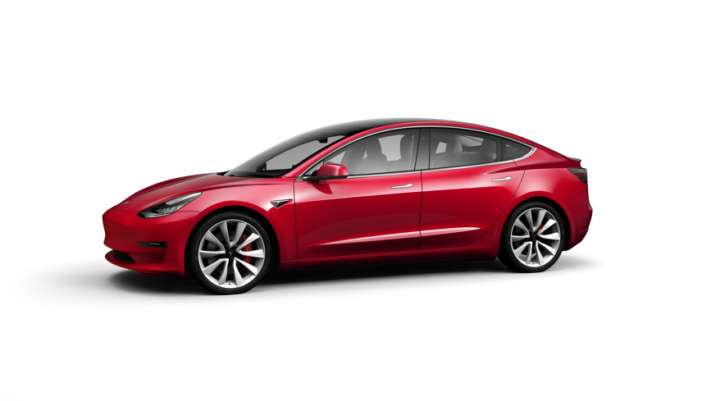
TESLA MODEL E
TF 5033 Electric Vehicle Energy System
Bernardus Rendy - 13317041

Slide 2
GENERAL OVERVIEW AND SPECIFICATION
TESLA

Slide 3
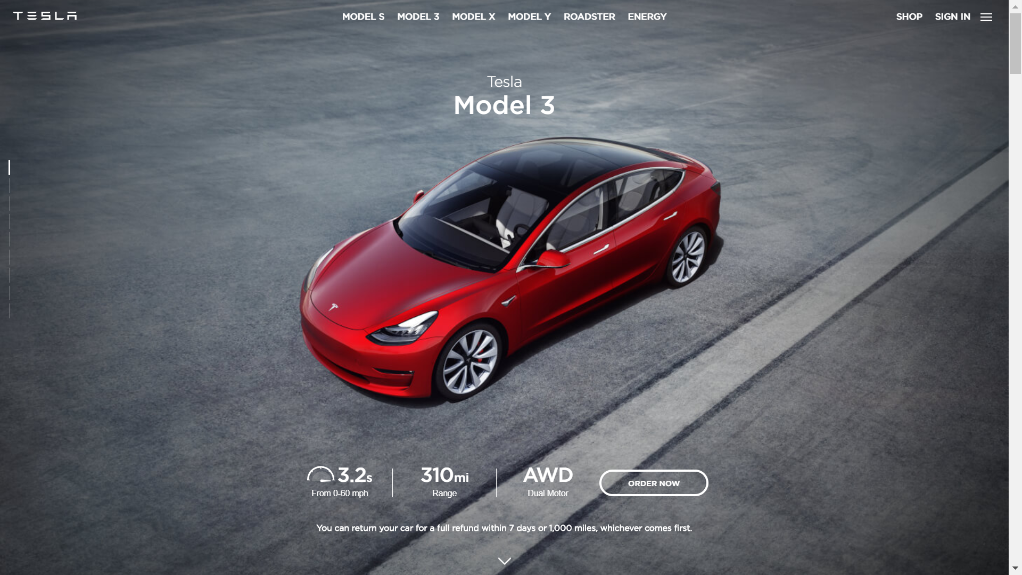
Notes:
Tesla Model 3 is the ultimate goal of tesla business plan, The third phase of tesla production plan, after model X, model S, and tesla roadster. It has 310 miles range for the performance and long range, and 240 miles for the standard range plus (slow acceleration as well, RWD).

Slide 4
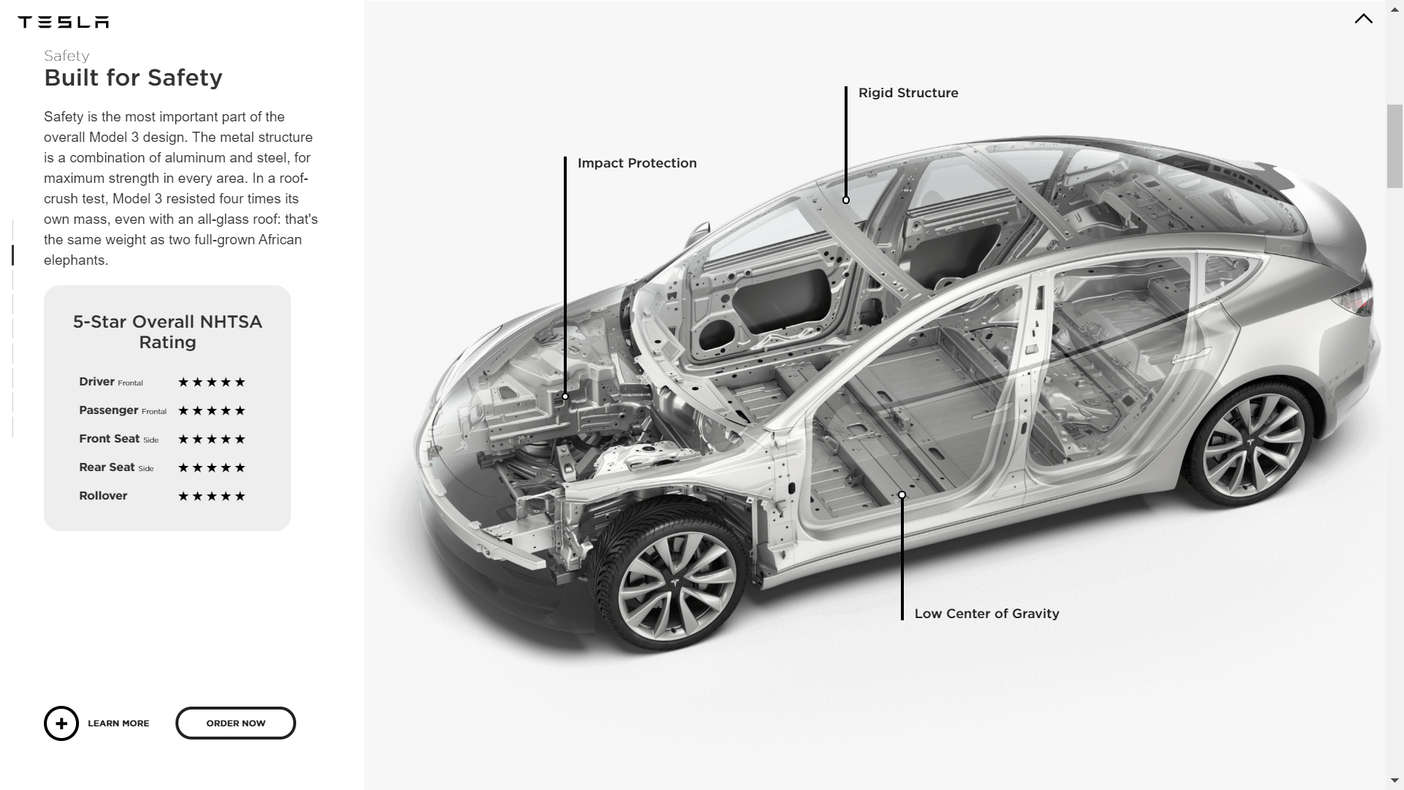
Notes:
Low CoG to counter imbalance and prone to roll over in sharp or emergency turn.

Slide 5
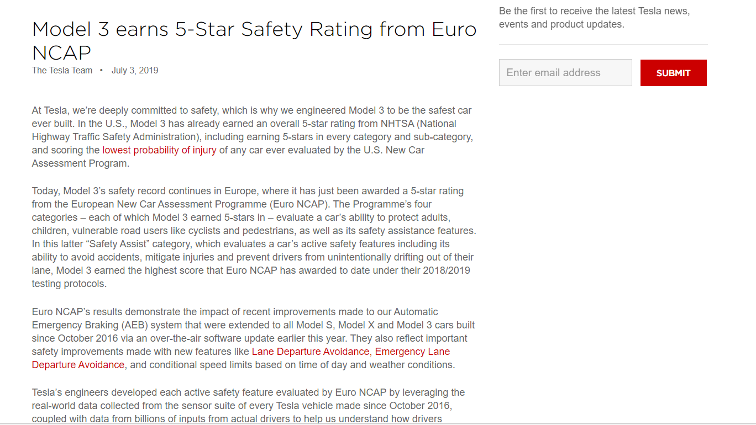

Slide 6
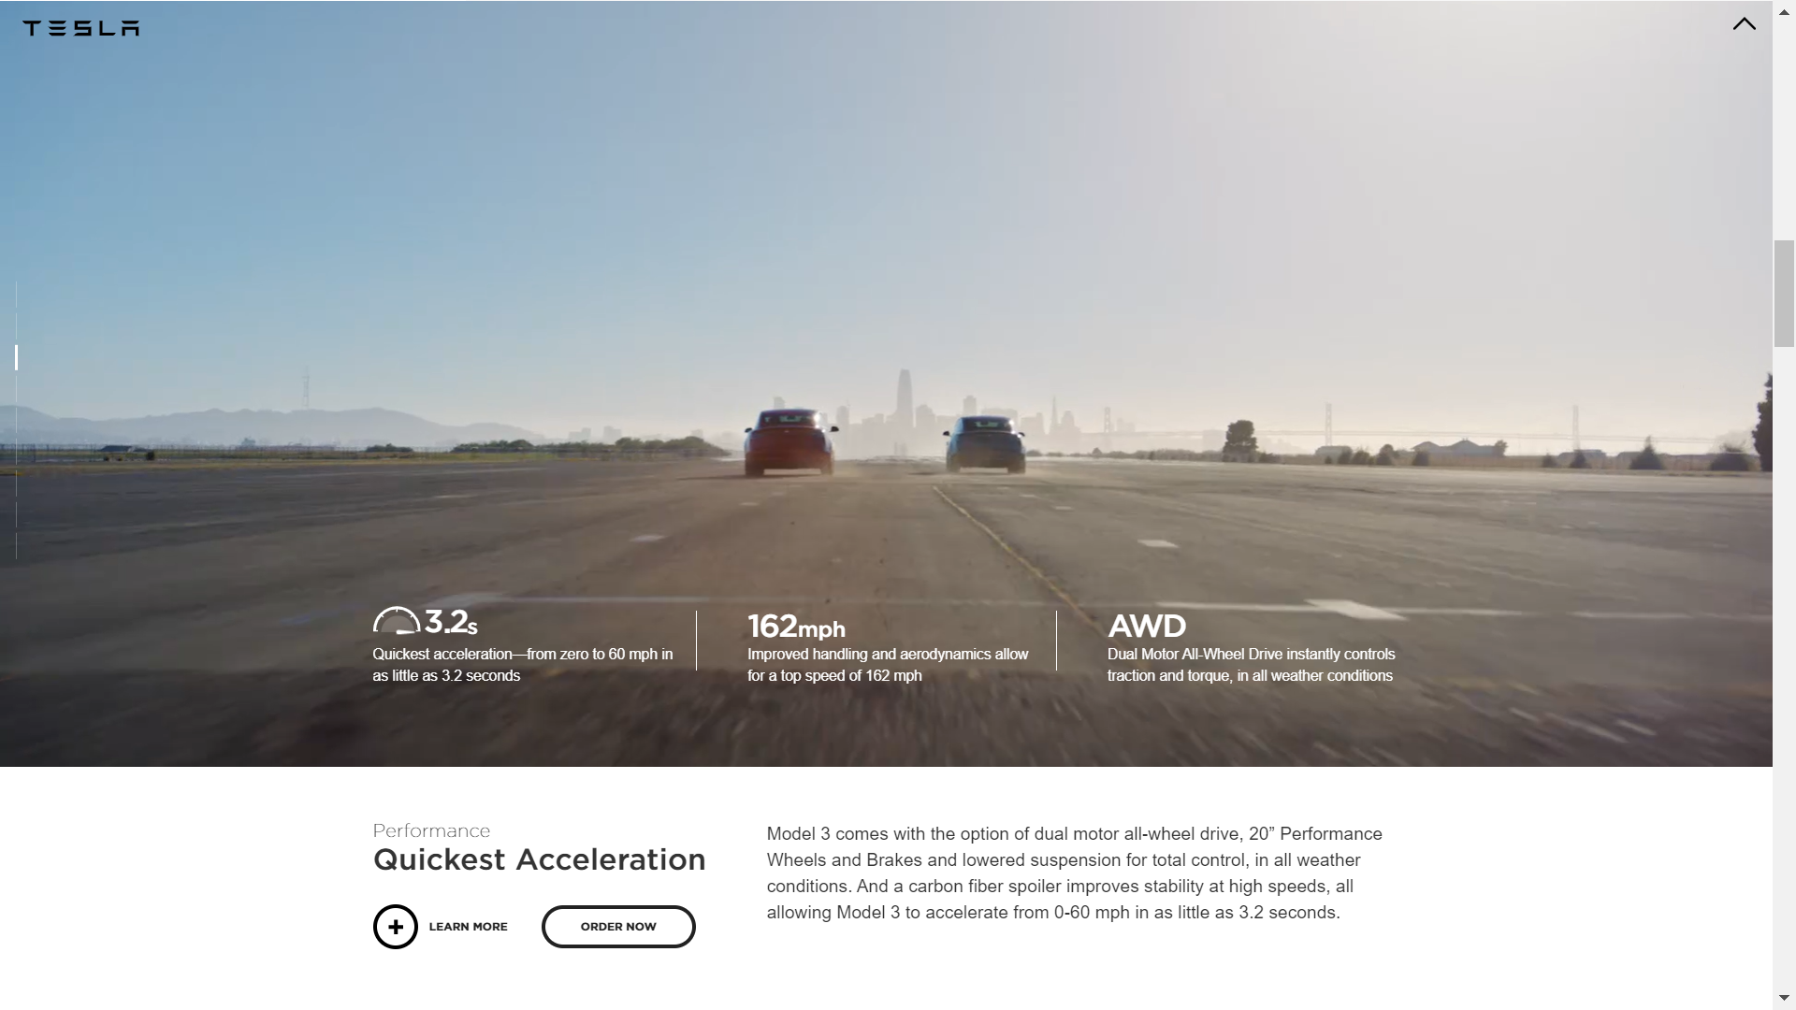

Slide 7
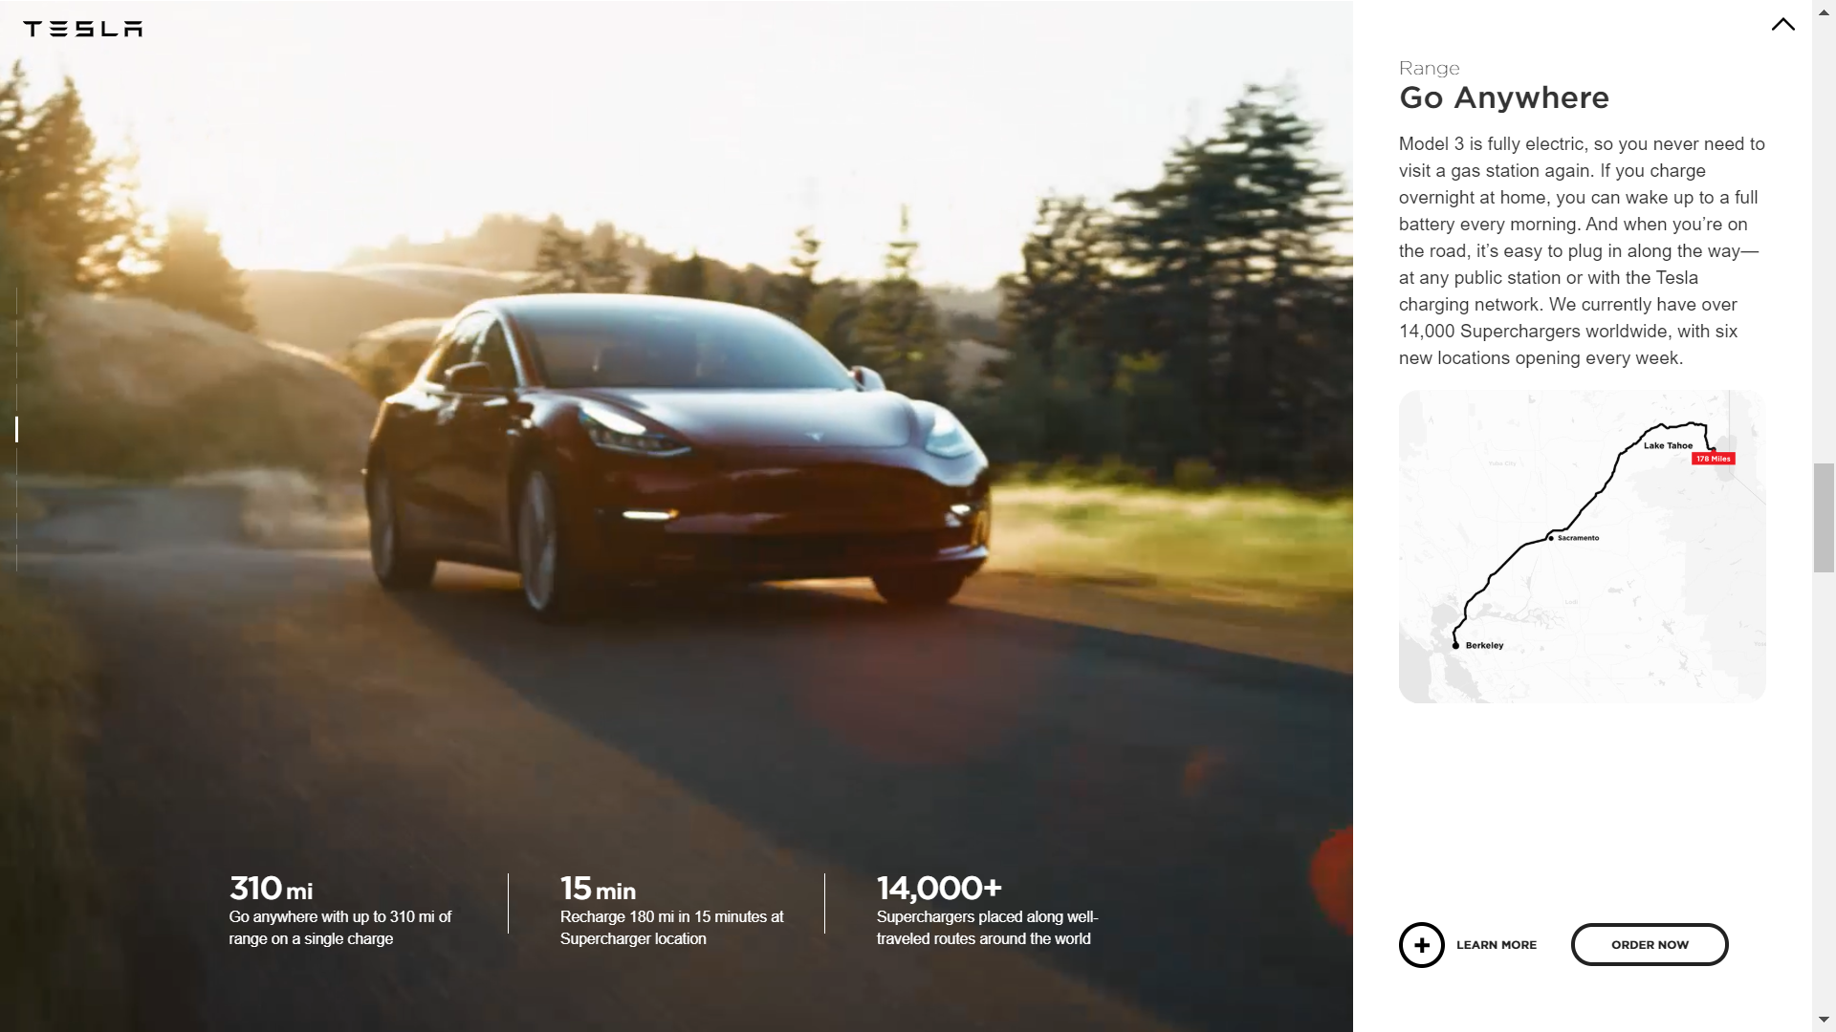
Notes:
310 miles = 499 km

Slide 8
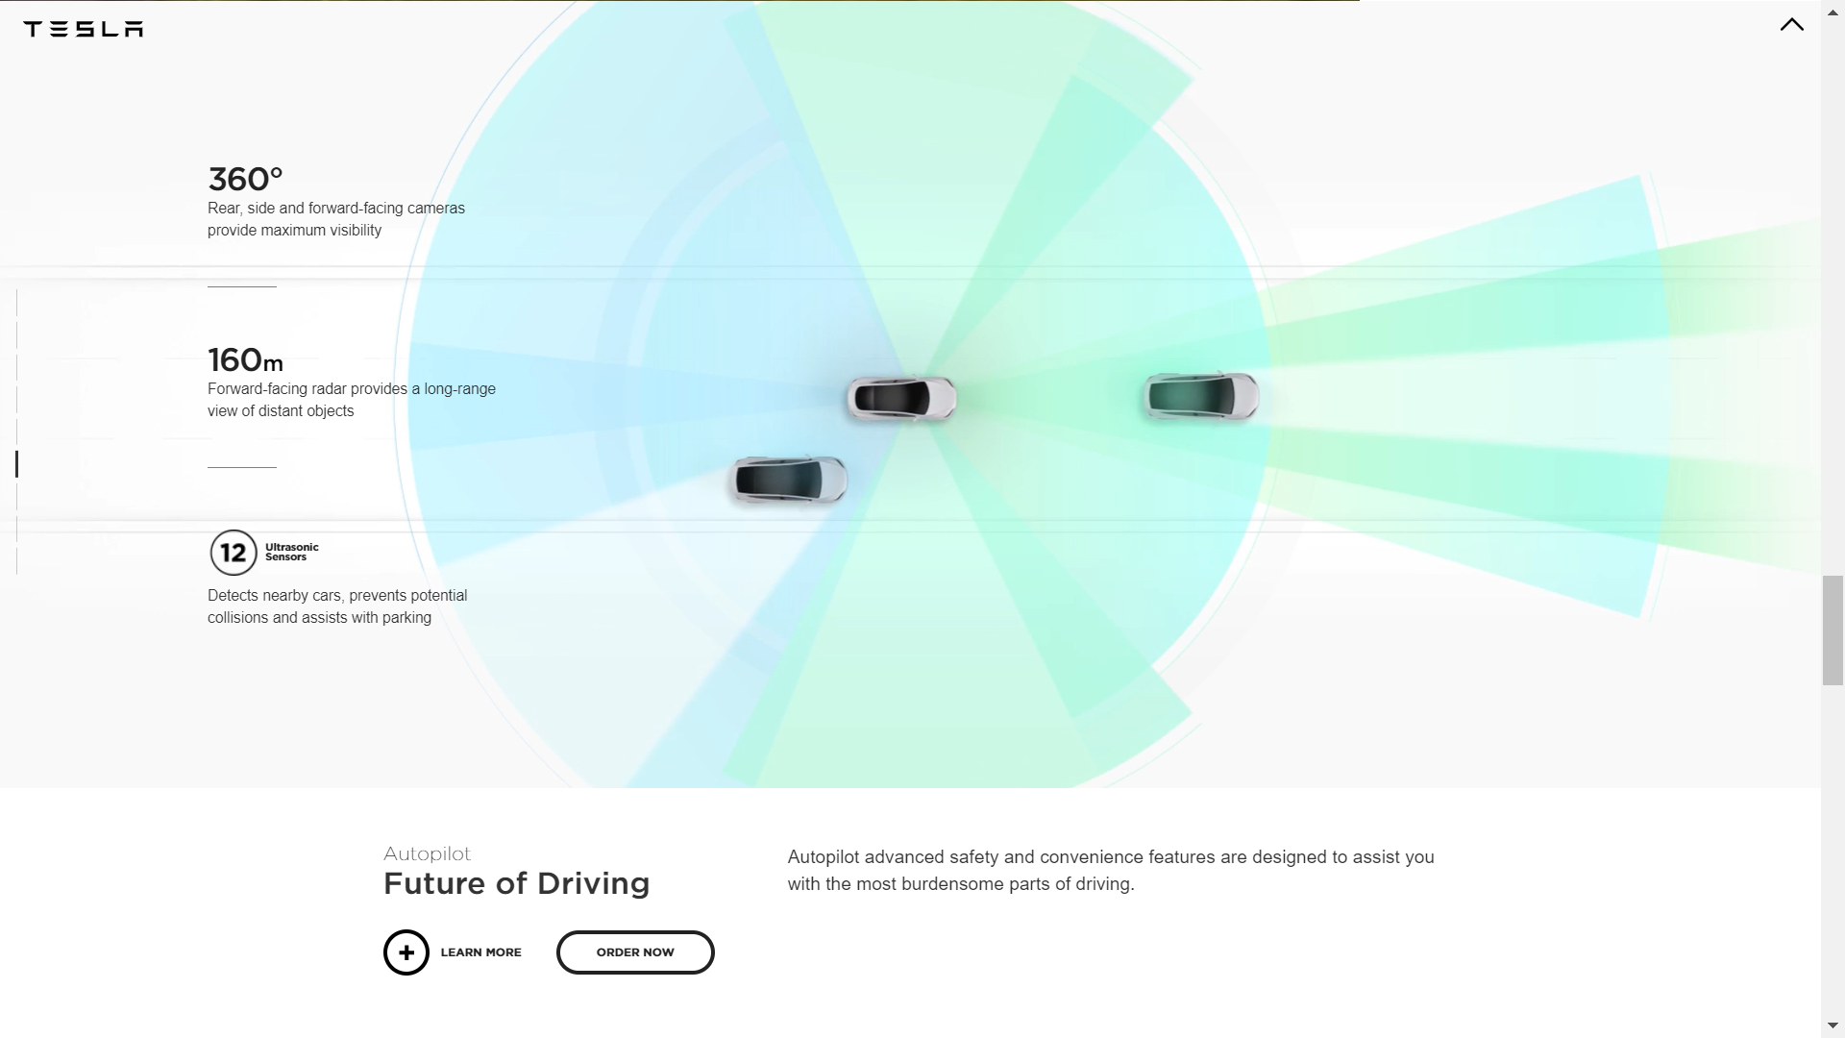

Slide 9
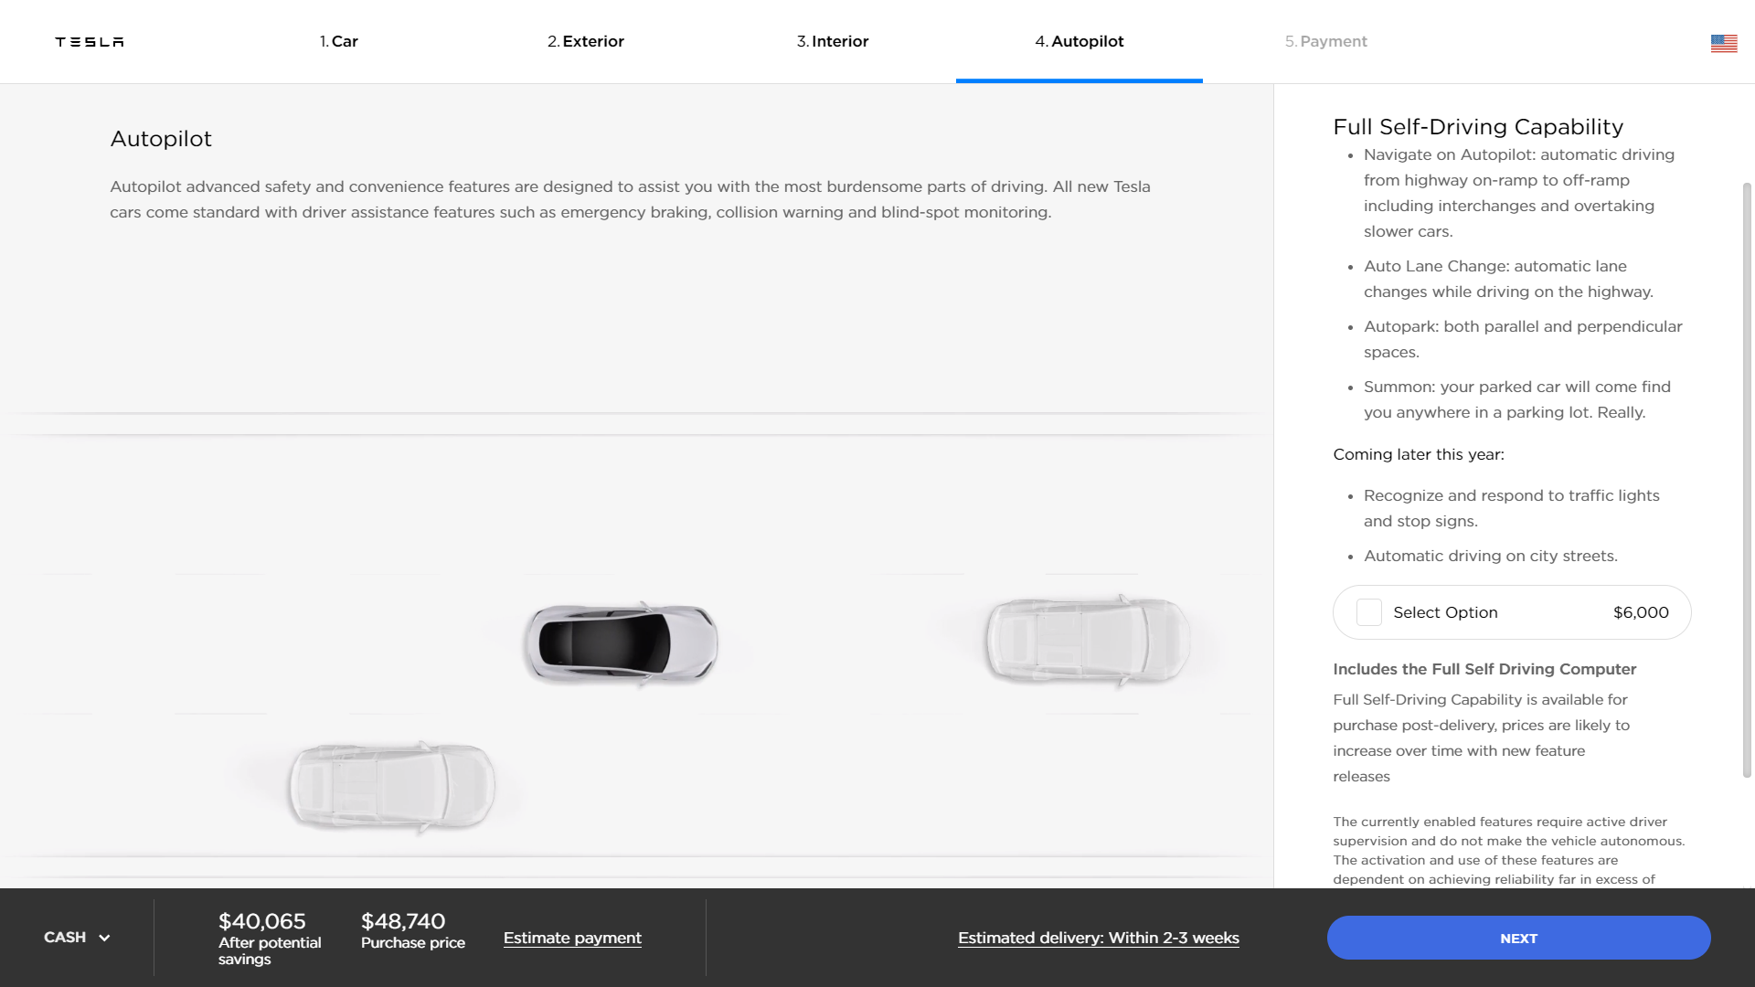
Notes:
The Tesla Model 3 will come standard with the Autopilot hardware and will use that hardware for safety features like emergency braking, but you will have to pay extra for activation of the convenience features such as Autopark, Summon, and Autosteer driving.

Slide 10
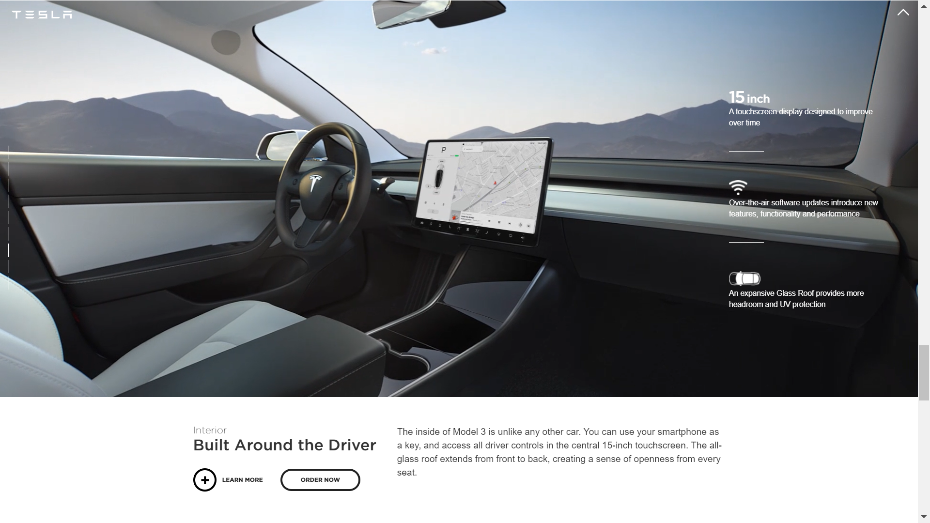

Slide 11
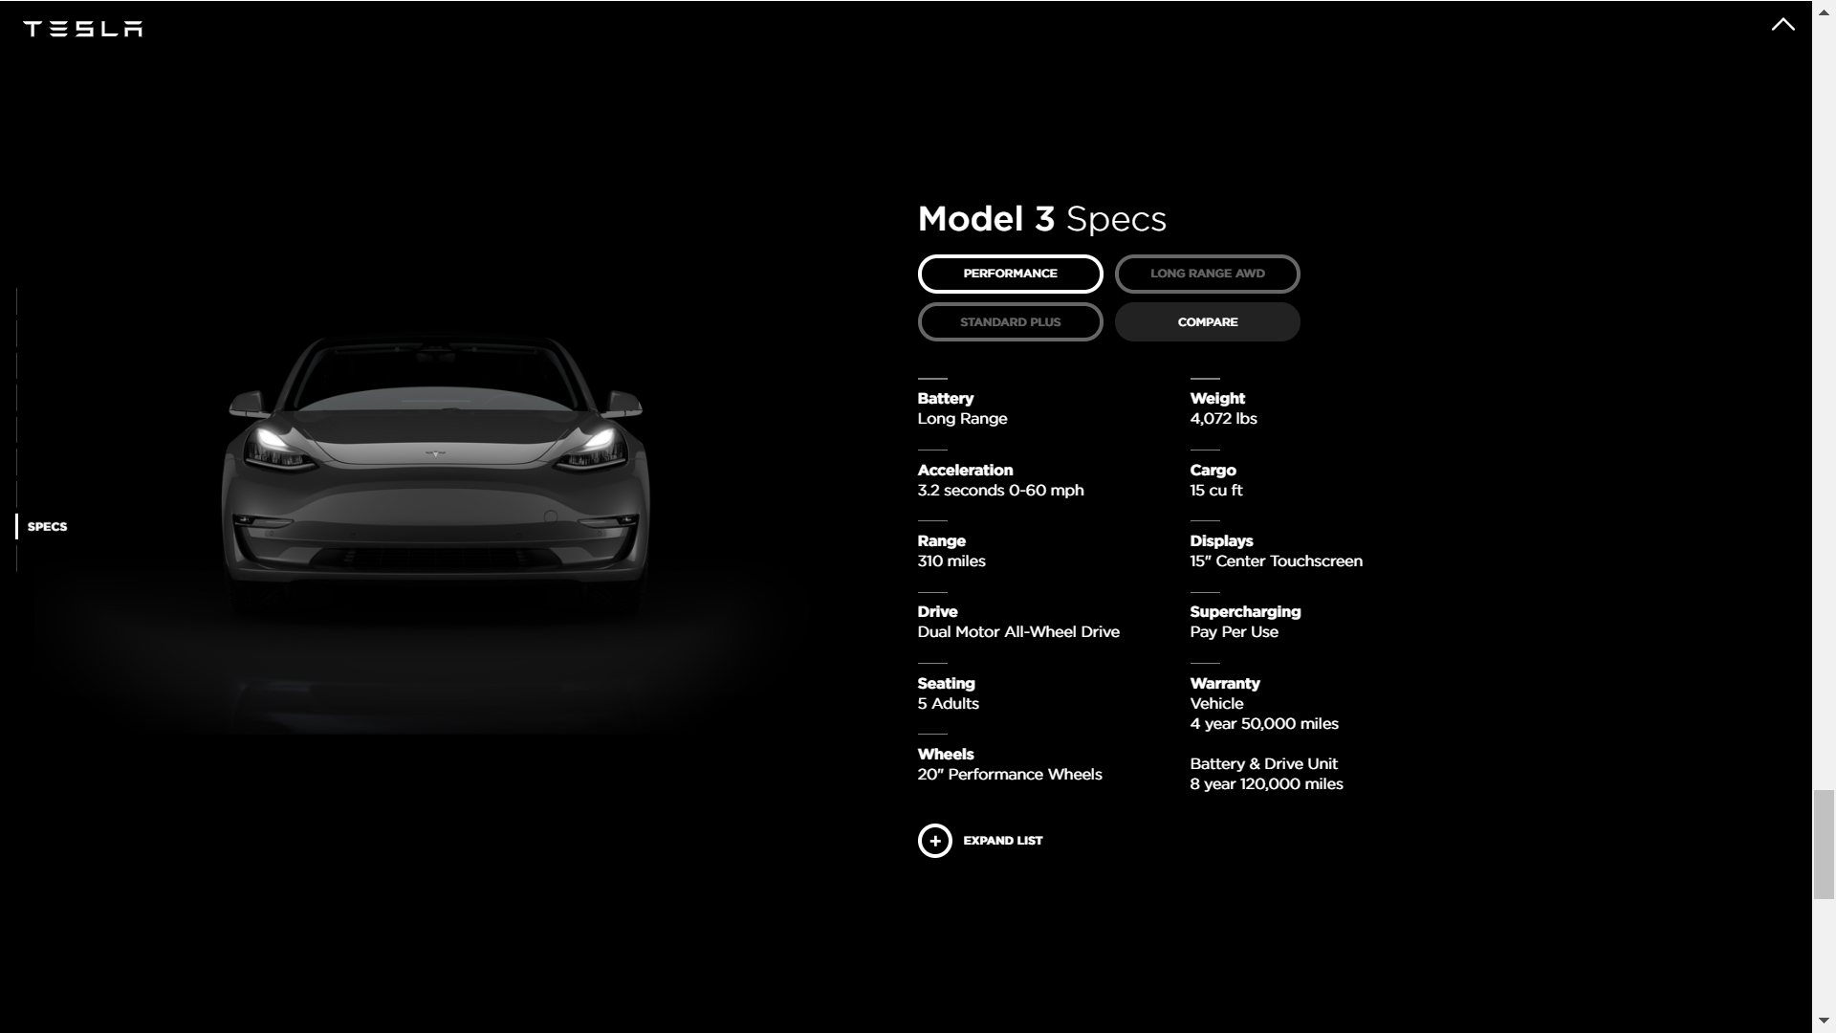

Slide 12
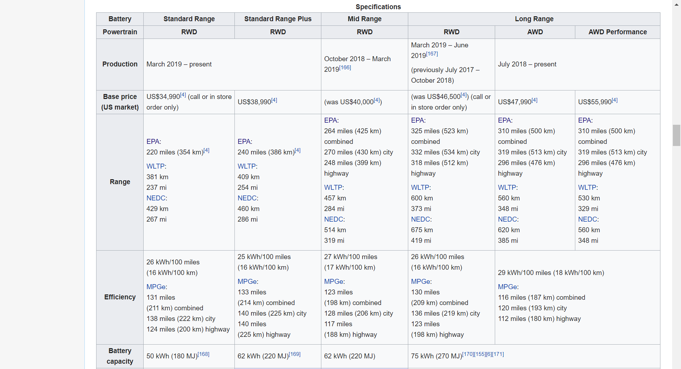
TESLA
Notes:
Model 3 standard range, long range rwd, and mid range has been discontinued. The minimum is now SR+, AWD Long Range, and AWD Performance

Slide 13
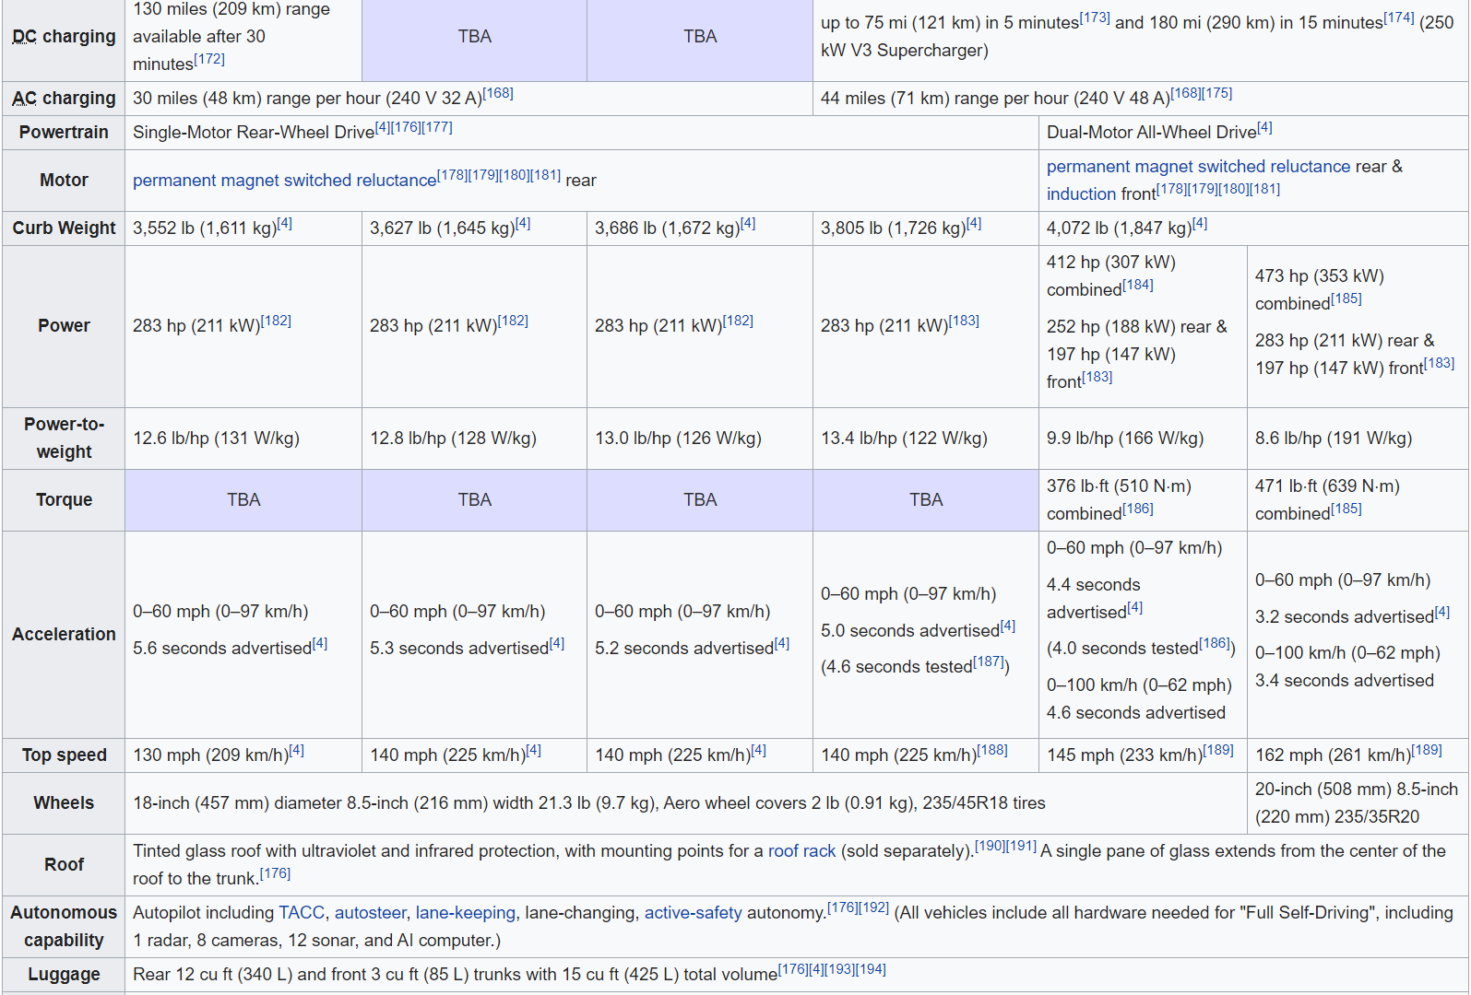
TESLA
Notes:
Model 3 standard range, long range rwd, and mid range has been discontinued. The minimum is now SR+, AWD Long Range, and AWD Performance

Slide 14
MECHANICAL ARCHITECTURE
TESLA

Slide 15
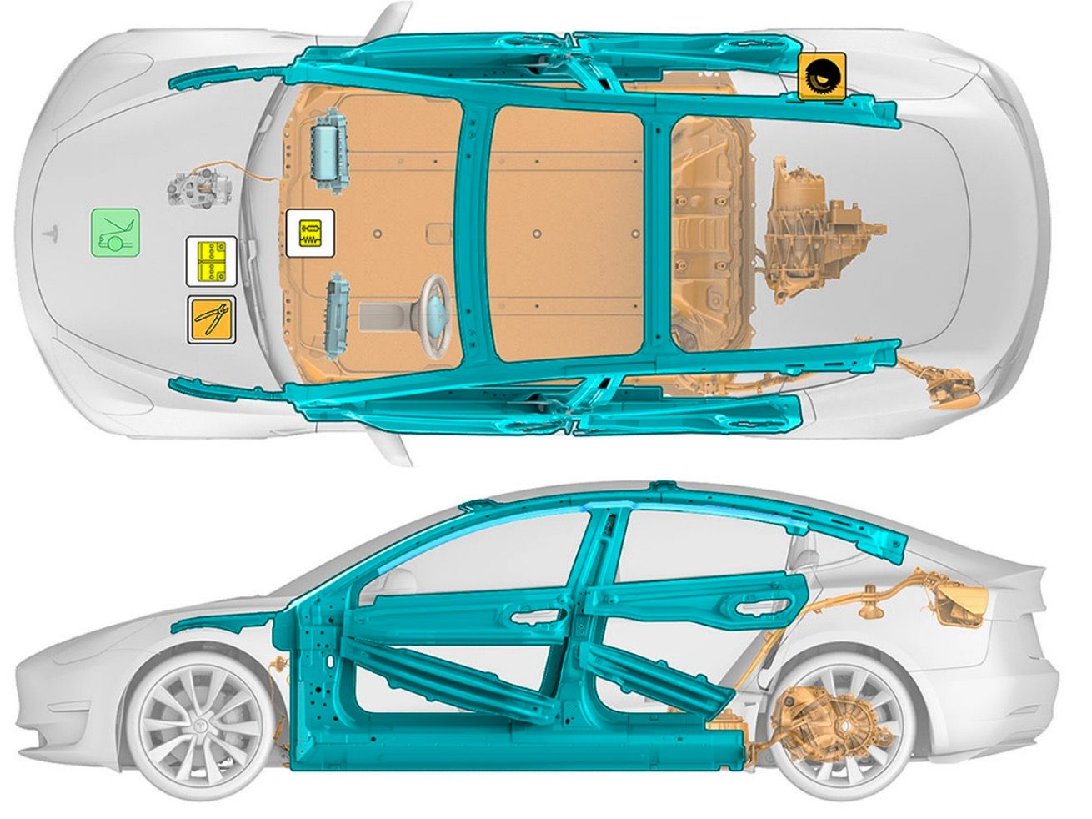
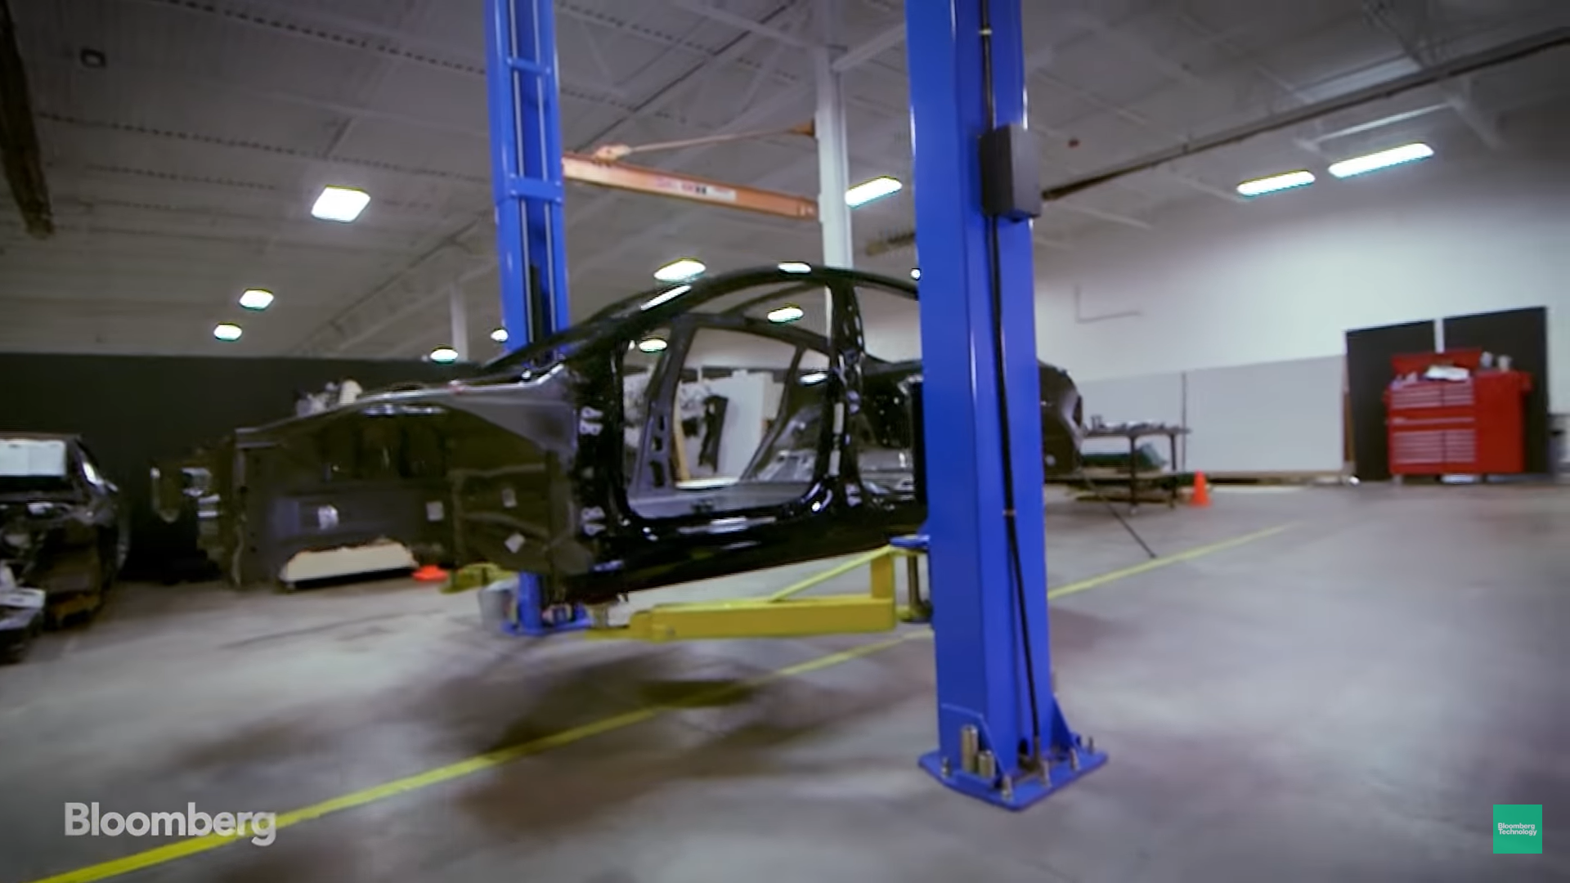
BODY DESIGN
TESLA
Notes:
Tesla model 3 body design is hard to be manufactured (Sandy Munro: a teardown specialist), it’s a whole new design no-one ever seen but the design will take a lot of manufacturing time, several parts has to be molded 7 steps where regular manufacturers will only mold it once (simpler shape).
Ultra high strength steel reinforcements are also shown in the teal parts

Slide 16
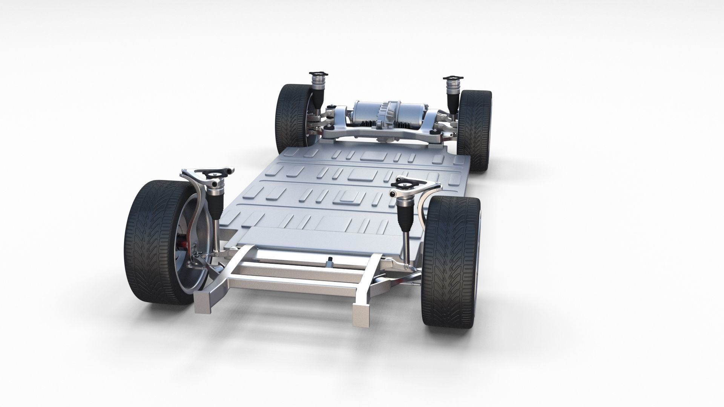
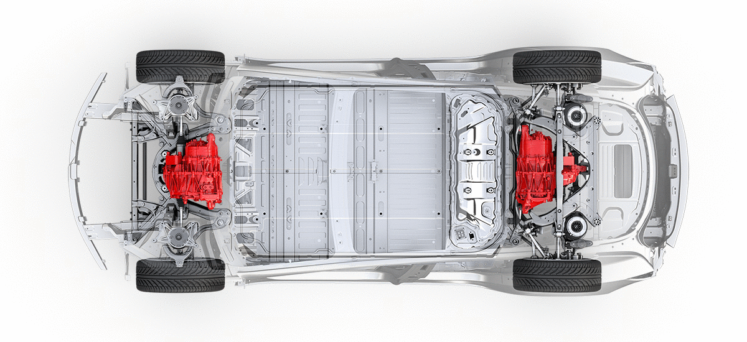
CHASSIS AND SYSTEMS COMPONENT PLACEMENT
TESLA
Notes:
First system is the induction motor, the induction motor placement for the AWD is shown at the top-right image, both motors are directly placed at the center to maintain CoG and inertia.
Second is the suspension system, Tesla actually used concepts from NASA when it was refining the suspension settings of the electric sedan. The electric car maker based the Model 3’s suspension settings on a study by the space agency about how long the human body can be subjected to a certain frequency without feeling uncomfortable. Considering that the vertical frequency of a suspension’s movement affects comfort and drivability, Tesla engineers settled on a vertical frequency that is equivalent to a brisk walk or a slow run to give the Model 3’s chassis a comfortable, sporty feel.

Slide 17
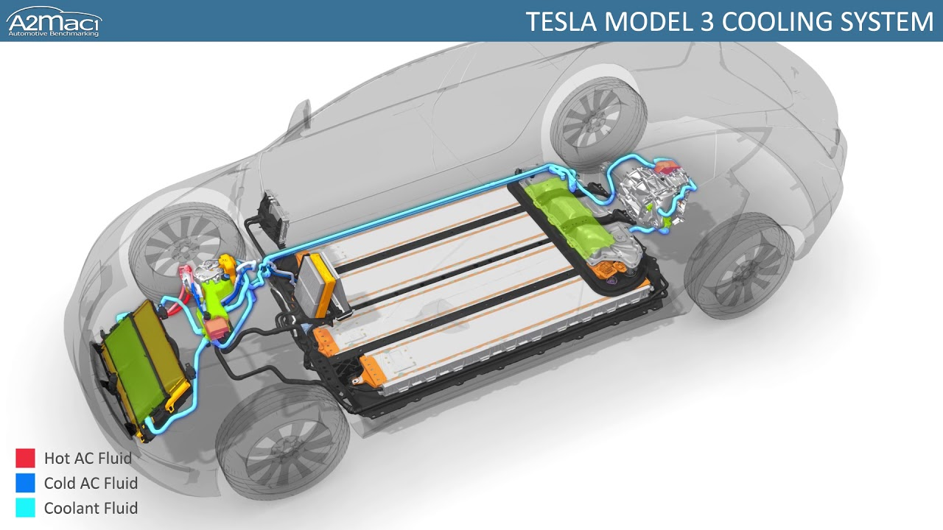
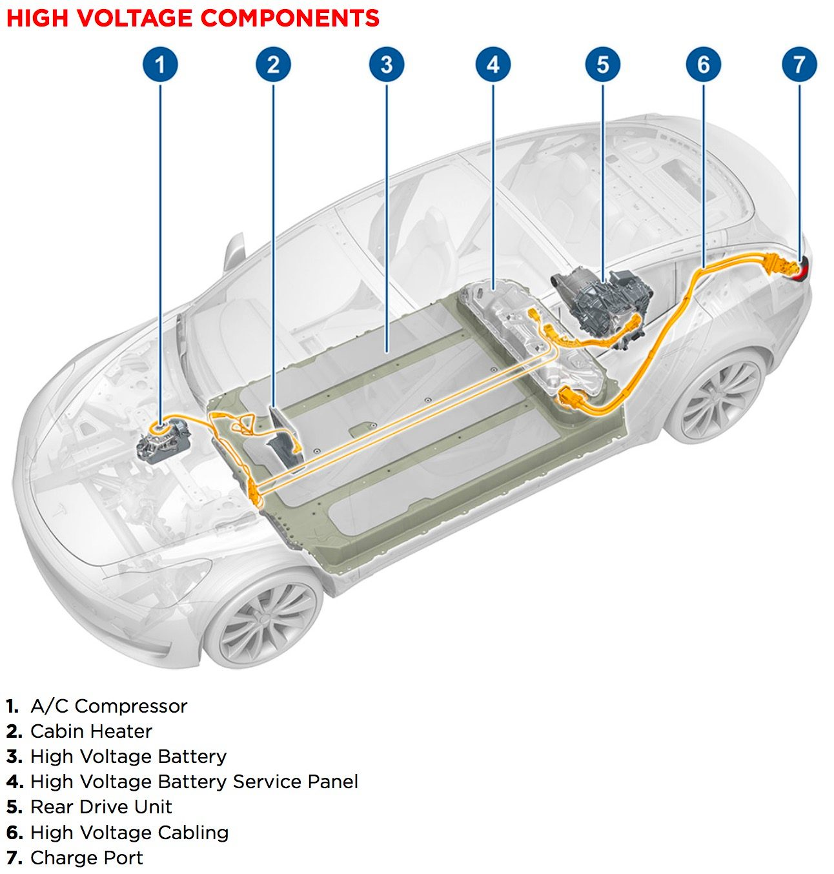
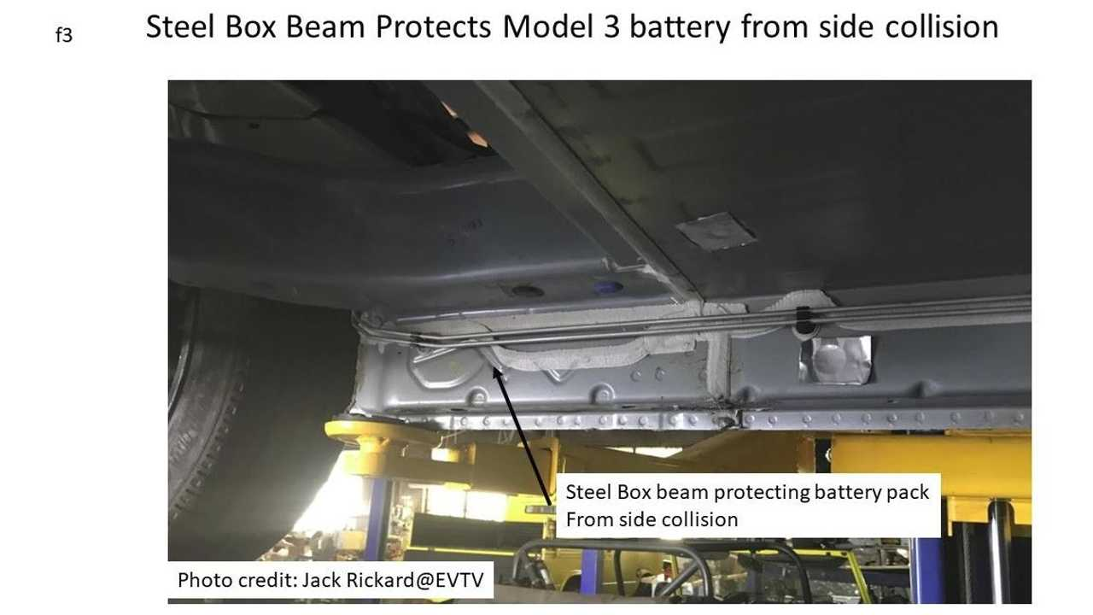
CHASSIS AND SYSTEMS COMPONENT PLACEMENT
TESLA
Notes:
Third is the battery and motor system (Cooling system included) is as shown, both active and passive cooling system. The battery is placed in the middle and bottom to maintain CoG and inertia
The high voltage components are as shown too, consisting of 7 parts. Placed in such place in consideration of safety and assembly easiness.
The steel box beam protects model 3 battery from side collision due to past events.

Slide 18
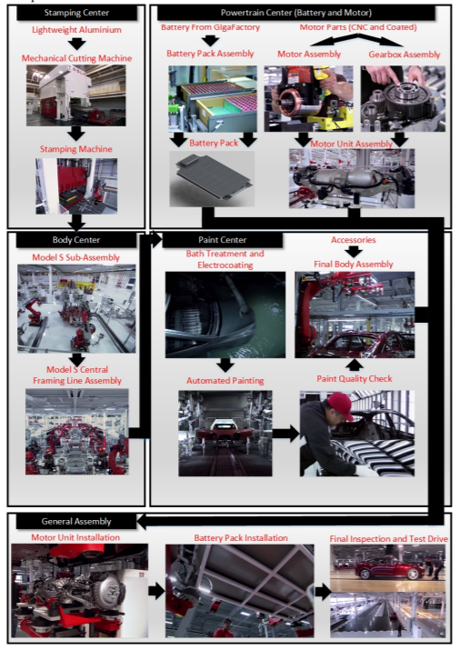
LITTLE DETOUR: MANUFACTURING PROCESS
TESLA
Notes:
This diagram shows how manufacturing process of tesla are done, the designs of systems and components placement are mainly adjusted to the manufacturing and assembly process of the vehicle. Model 3 is a high volume market segmented car therefore has to be produced at high speed. From the diagram we can infer that the body and powertrain are manufactured separately and assembled in the end, this implicates to component placement that focuses at design requirement (CoG, Rotational Resistance, Acceleration property, Power-to-weight ratio, Vehicle dynamics, etc)

Slide 19
LITTLE DETOUR: MANUFACTURING PROCESS
TESLA
Notes:
This diagram shows how manufacturing process of tesla are done, the designs of systems and components placement are mainly adjusted to the manufacturing and assembly process of the vehicle. Model 3 is a high volume market segmented car therefore has to be produced at high speed. From the diagram we can infer that the body and powertrain are manufactured separately and assembled in the end, this implicates to component placement that focuses at design requirement (CoG, Rolling Resistance, Acceleration property, Power-to-weight ratio, Vehicle dynamics, etc)

Slide 20
DRIVETRAIN AND MECHANICAL SAFETY SYSTEMS
TESLA

Slide 21
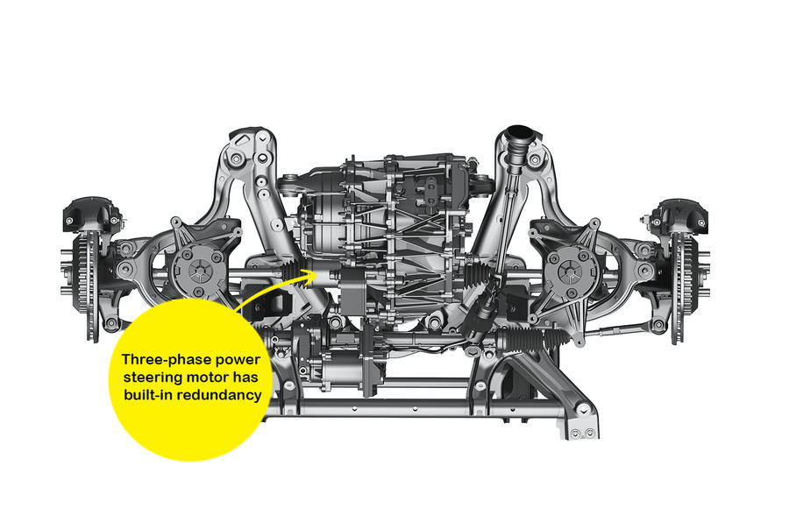
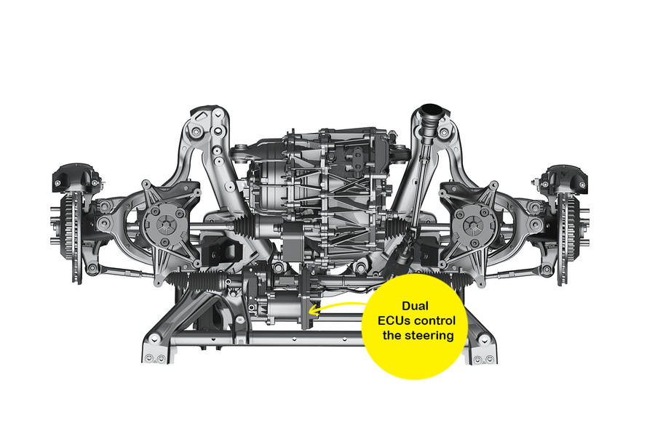
STEERING
TESLA
Notes:
The Model 3 has earned a perfect 5-Star Safety Rating from the NHTSA, the Euro-NCAP, and the ANCAP. This comes as no surprise, considering that the vehicle is designed from the ground up to emphasize safety. The Model 3’s front suspension, for example, was specifically designed to provide maximum protection in small-overlap frontal collision crash tests.
The electric power steering system has a rapid 10:1 ratio, giving two turns lock-to-lock. The system has full redundancy with separate power feeds taken directly from the high-voltage battery, two electronic control modules and two inverters providing ‘hot backup’ if one fails.

Slide 22
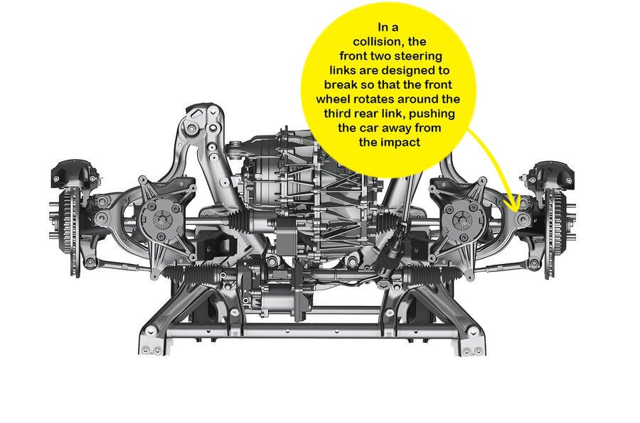
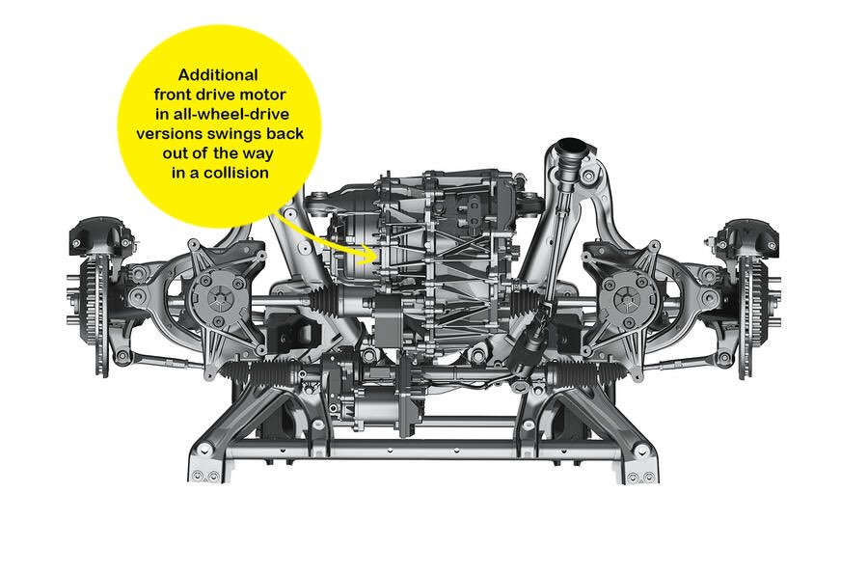
COLLISION PROTECTION
TESLA
Notes:
Sacrificial links that are designed to snap when the front wheel and suspension get damaged are also integrated into the vehicle, allowing the Model 3’s front wheels to rotate. This moves the front wheels outside the Model 3’s body, while pushing the car, its occupants, and its battery pack from the point of impact. These safety systems extend to the Model 3’s dual-motor AWD variants as well.

Slide 23
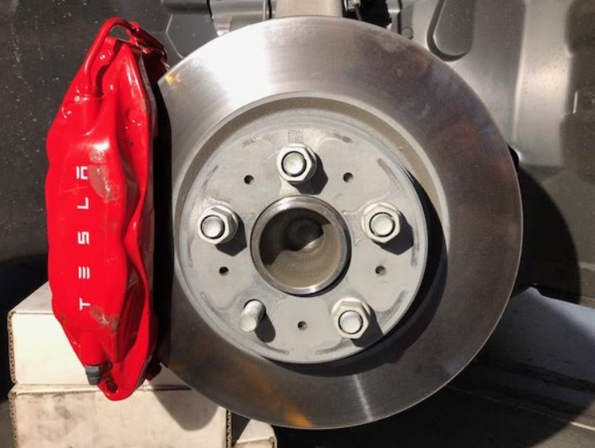
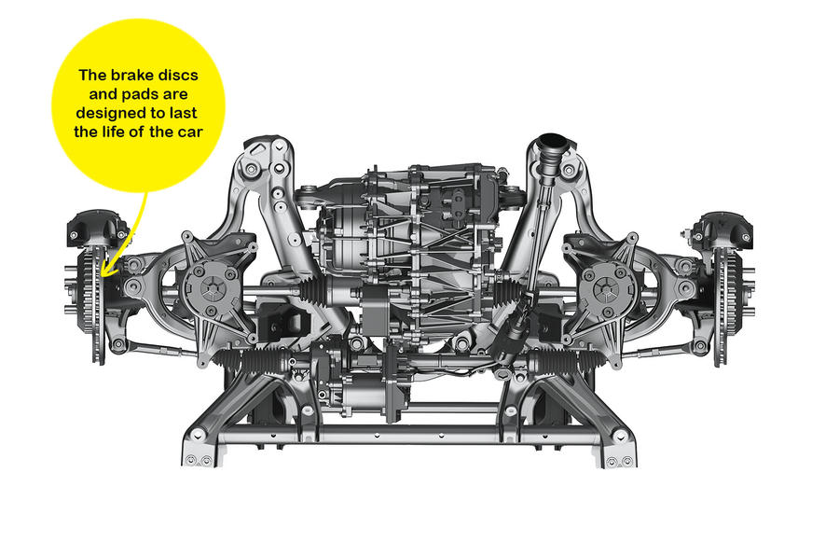
REGENERATIVE BRAKING SYSTEM
TESLA
Notes:
The Model 3’s braking system is quite unique, in the way that Tesla opted to equip the electric sedan with more expensive four-pot brake calipers at the front wheels instead of a single-piston sliding mechanism. This gives the Model 3 superior pedal response, and it opened the door for the electric car maker to design its own piston seals that fully retract the brake pads after braking; thus, boosting available driving range and cutting drag. Such a system adds to the Model 3’s efficiency, which has proven superior to other premium electric vehicles like the Audi e-tron and the Jaguar I-PACE.
Elon Musk has mentioned multiple times in the past that brake pads in a Tesla will last for the lifetime of a vehicle. This is no exaggeration, according to the Tesla engineers, who noted that the Model 3’s discs and brake pads are designed to last for around 150,000 miles. This is made possible by the Model 3’s regenerative braking system, which allows drivers to slow down the vehicle without using its physical brakes. As for rust issues, the engineers pointed out that Tesla has developed new anti-corrosion techniques for its electric cars.

Slide 24
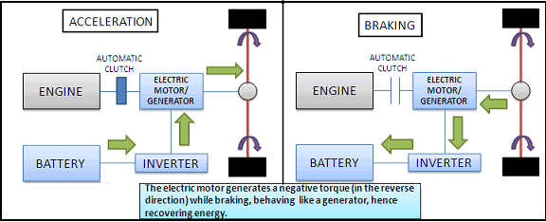
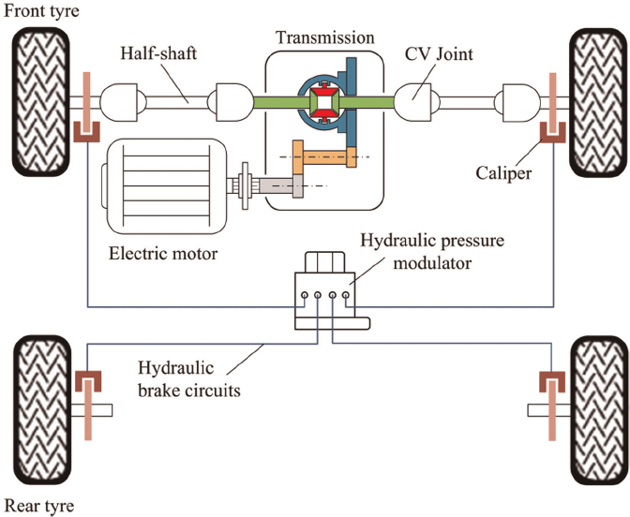
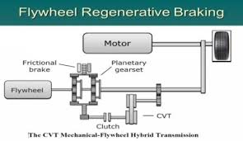
REGENERATIVE BRAKING SYSTEM
TESLA
Notes:
The left diagram simulates how regenerative braking works, simplifying the braking system by removing the hydraulic brake as shown before. The hydraulic brake system is shown on the right diagram. The need of hydraulic brake is due to the inability of regenerative braking to meet highway requirement and the inability of inverter and battery capability to manage such huge energy input. The advancement in regenerative braking system is ultracapacitor to capture high density power and to enhance the energy storage system’s energy density.

Slide 25
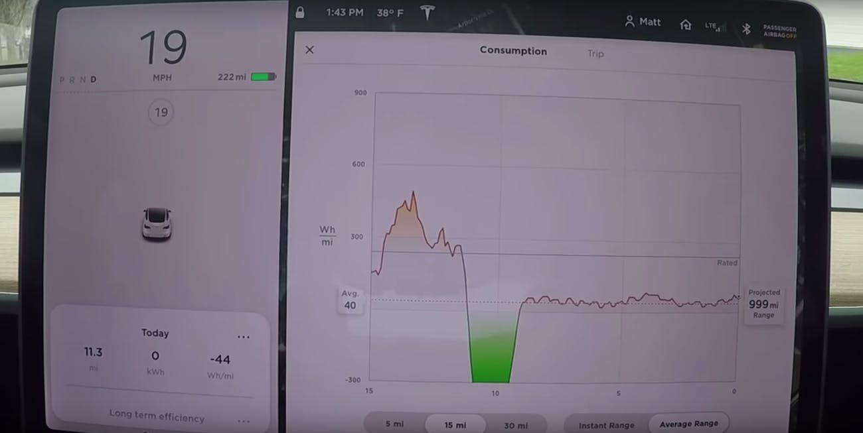
REGENERATIVE BRAKING SYSTEM
TESLA
Notes:
On November 7 Matt Shumaker posted a video on his YouTube channel, Tech Forum demonstrating how he got roughly 12 miles of range for one mile of towing. Shumaker and his son hitched the Model 3 to the back of a 2013 Ford C-Max Hybrid and took it for a spin going roughly 18 miles an hour.
After towing it for a mile, Shumaker was able to drive the car for 12.8 miles, at the same 18mph speed, before it started eating into the battery. He noted that if you were to drive between 30 and 35mph, one mile of towing leads to a charge that can last up to five miles. That’s not too bad for a leisurely ride around the neighborhood, but don’t go trying this yourself.

Slide 26
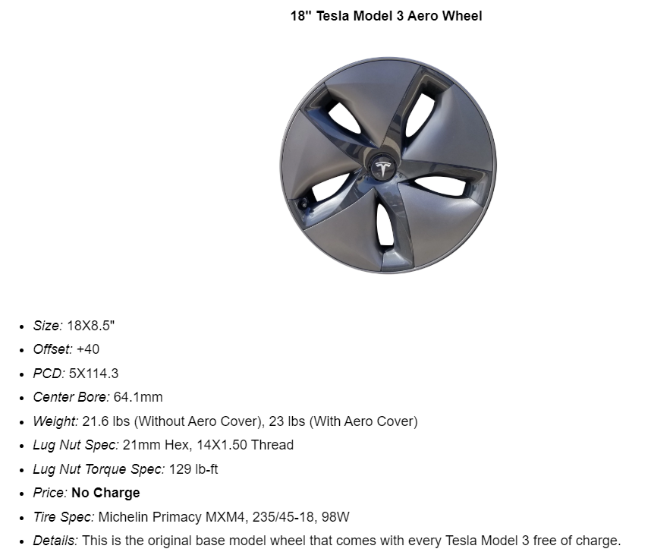
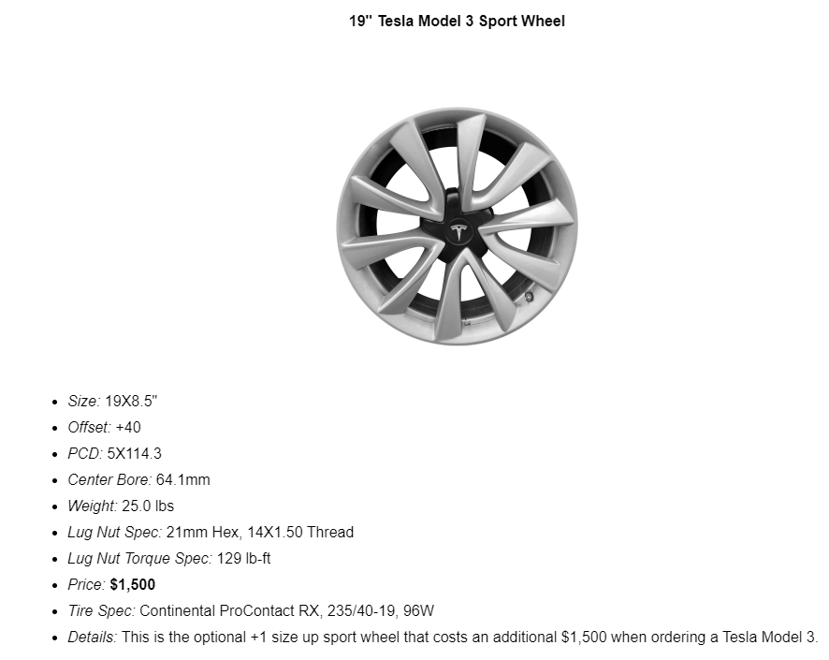
WHEELS AND TIRES
TESLA
Notes:
Tesla says tires for a high-performance electric vehicle are challenged in a way that those on a car powered by an internal combustion engine (ICE) are not. A two-wheel-drive Model 3 with a long-range battery weighs just over 1700kg, so tires have to cope with high loads as well as a 155mph top speed (for dual motor versions) plus continual torque input, either when accelerating or during regenerative braking.
The bulk of mass of an EV is usually located lower than in an ICE-powered car due to the battery packs being mounted under the floor. As a result, there is less vertical force build-up through the outside pair of tires to generate grip when they corner. To tackle that, Tesla focused on tread stiffness, developing new compounds to deliver the desired combination of cornering grip and low rolling resistance. The tires are filled with sound-absorbing foam to suppress noise amplified inside the tire cavity.

Slide 27
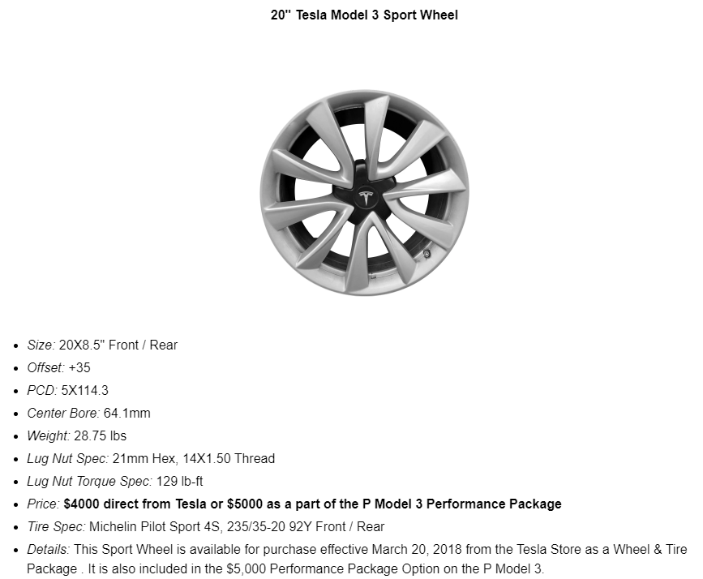
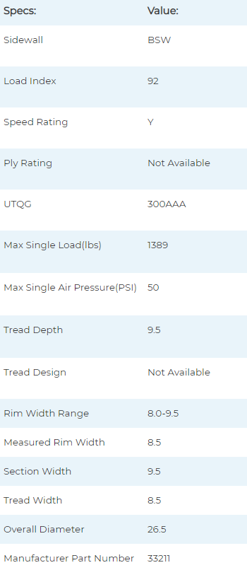
WHEELS AND TIRES
TESLA
Notes:
Tesla says tires for a high-performance electric vehicle are challenged in a way that those on a car powered by an internal combustion engine (ICE) are not. A two-wheel-drive Model 3 with a long-range battery weighs just over 1700kg, so tires have to cope with high loads as well as a 155mph top speed (for dual motor versions) plus continual torque input, either when accelerating or during regenerative braking.
The bulk of mass of an EV is usually located lower than in an ICE-powered car due to the battery packs being mounted under the floor. As a result, there is less vertical force build-up through the outside pair of tires to generate grip when they corner. To tackle that, Tesla focused on tread stiffness, developing new compounds to deliver the desired combination of cornering grip and low rolling resistance. The tires are filled with sound-absorbing foam to suppress noise amplified inside the tire cavity.
ICE usually has 30-35 PSI, Tesla recommended pressure is 39-45 psi for 20” Model 3

Slide 28
DRIVE UNIT
TESLA

Slide 29
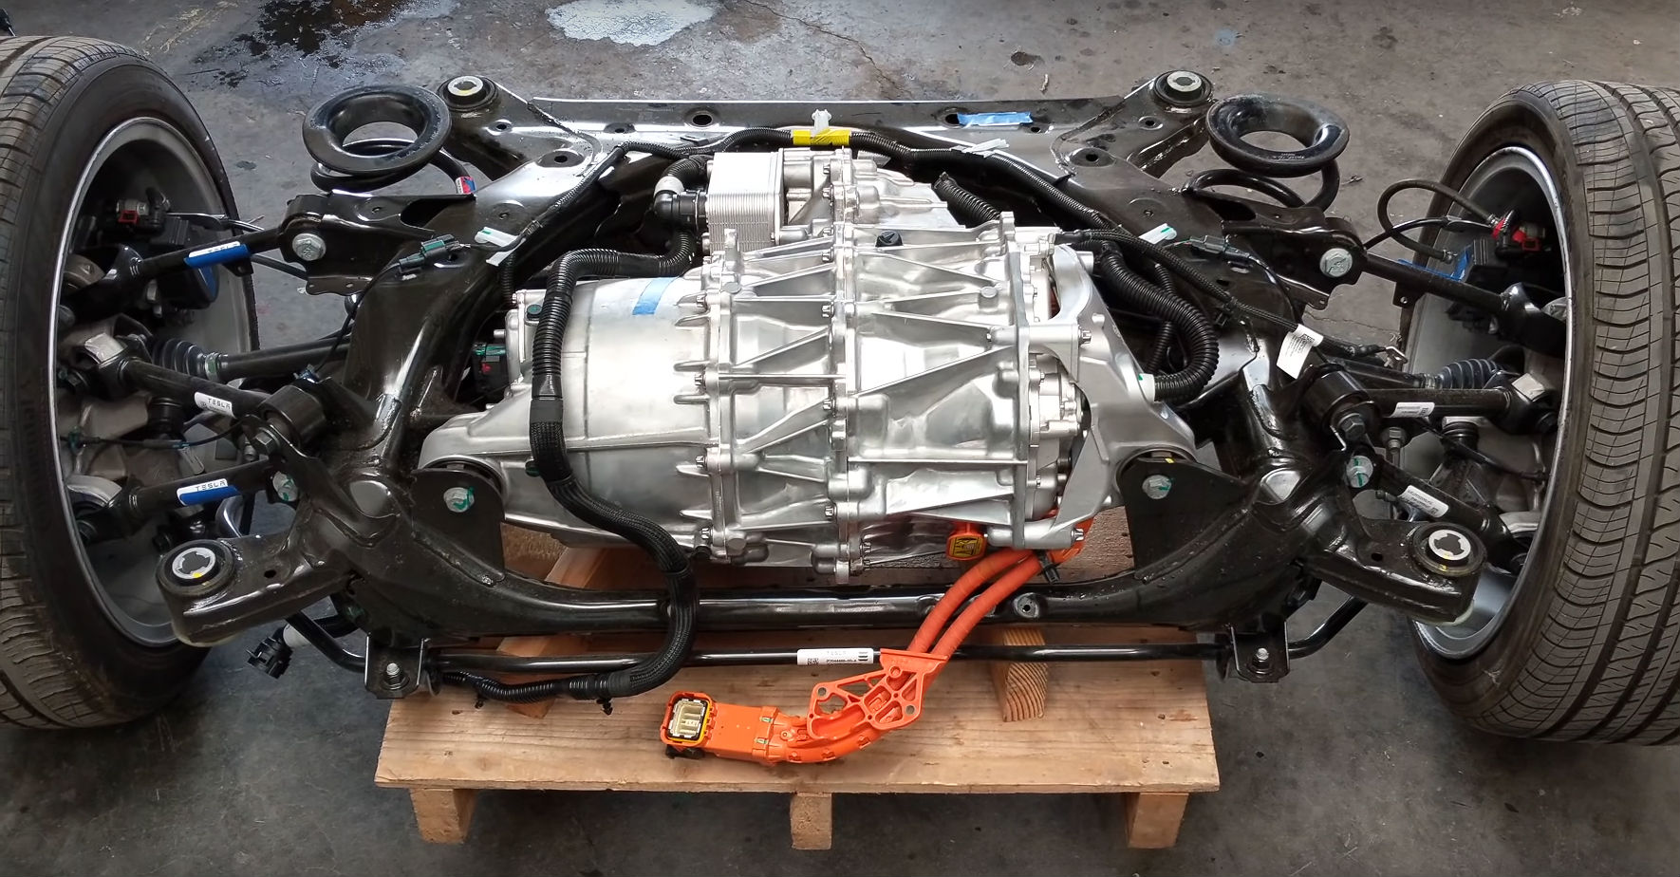
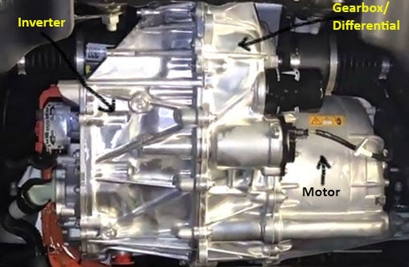
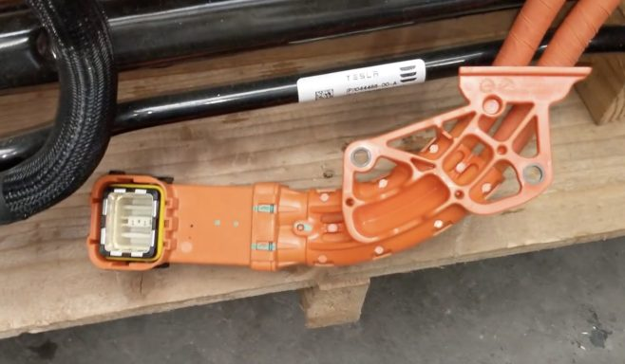
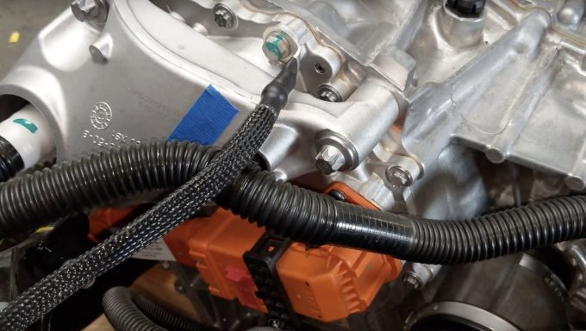
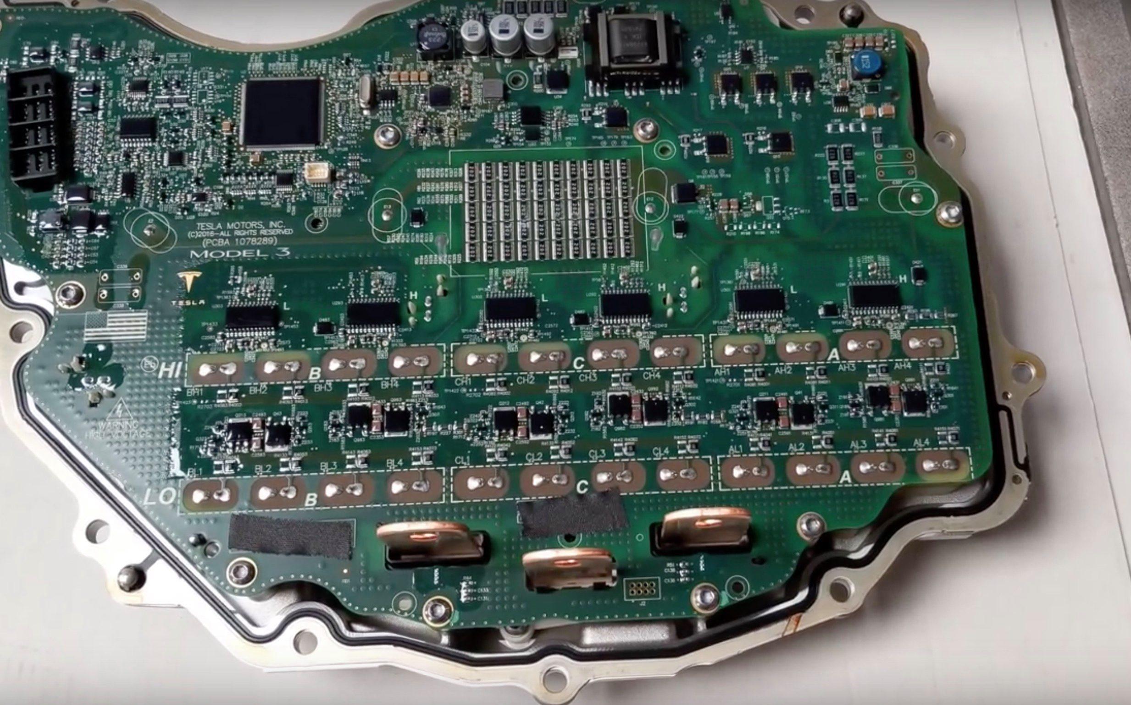
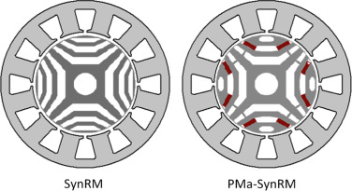
PERMANENT MAGNET SWITCHED RELUCTANCE MOTOR
TESLA
Notes:
The inverter for the Model 3 drive unit uses 24 pairs of Silicon Carbide (SiC) MOSFET chips rated for 650 volts each.^{[161]}

Slide 30
PERMANENT MAGNET SWITCHED RELUCTANCE MOTOR
Powertrain | RWD | AWD Performance
Motor | permanent magnet switched reluctance rear | permanent magnet switched reluctance rear & induction front
Curb Weight | 3,552 lb (1,611 kg) | 4,072 lb (1,847 kg)
Power | 283 hp (211 kW) | 473 hp (353 kW) combined 283 hp (211 kW) rear & 197 hp (147 kW) front
Torque | 376 lb⋅ft (510 N⋅m) combined | 471 lb⋅ft (639 N⋅m) combined
TESLA

Slide 31
ENERGY STORAGE SYSTEM, BATTERY MANAGEMENT SYSTEM, ELECTRICAL SYSTEM, AND UTILITIES
TESLA

Slide 32
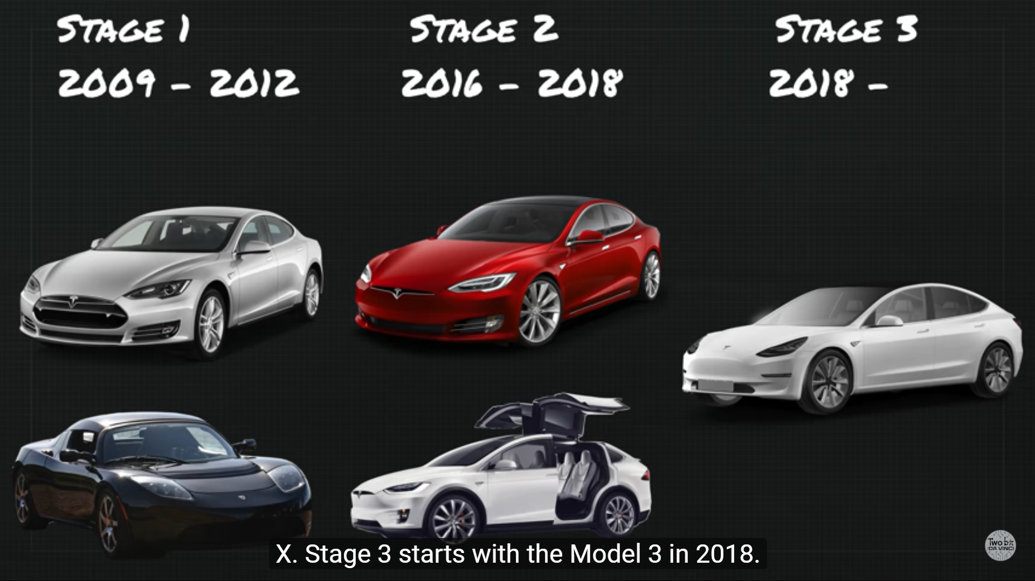
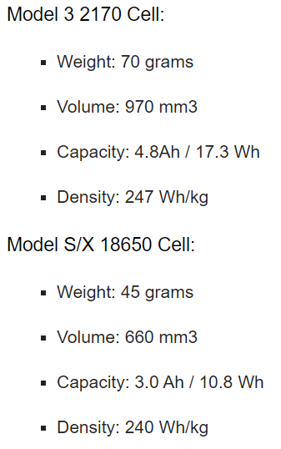
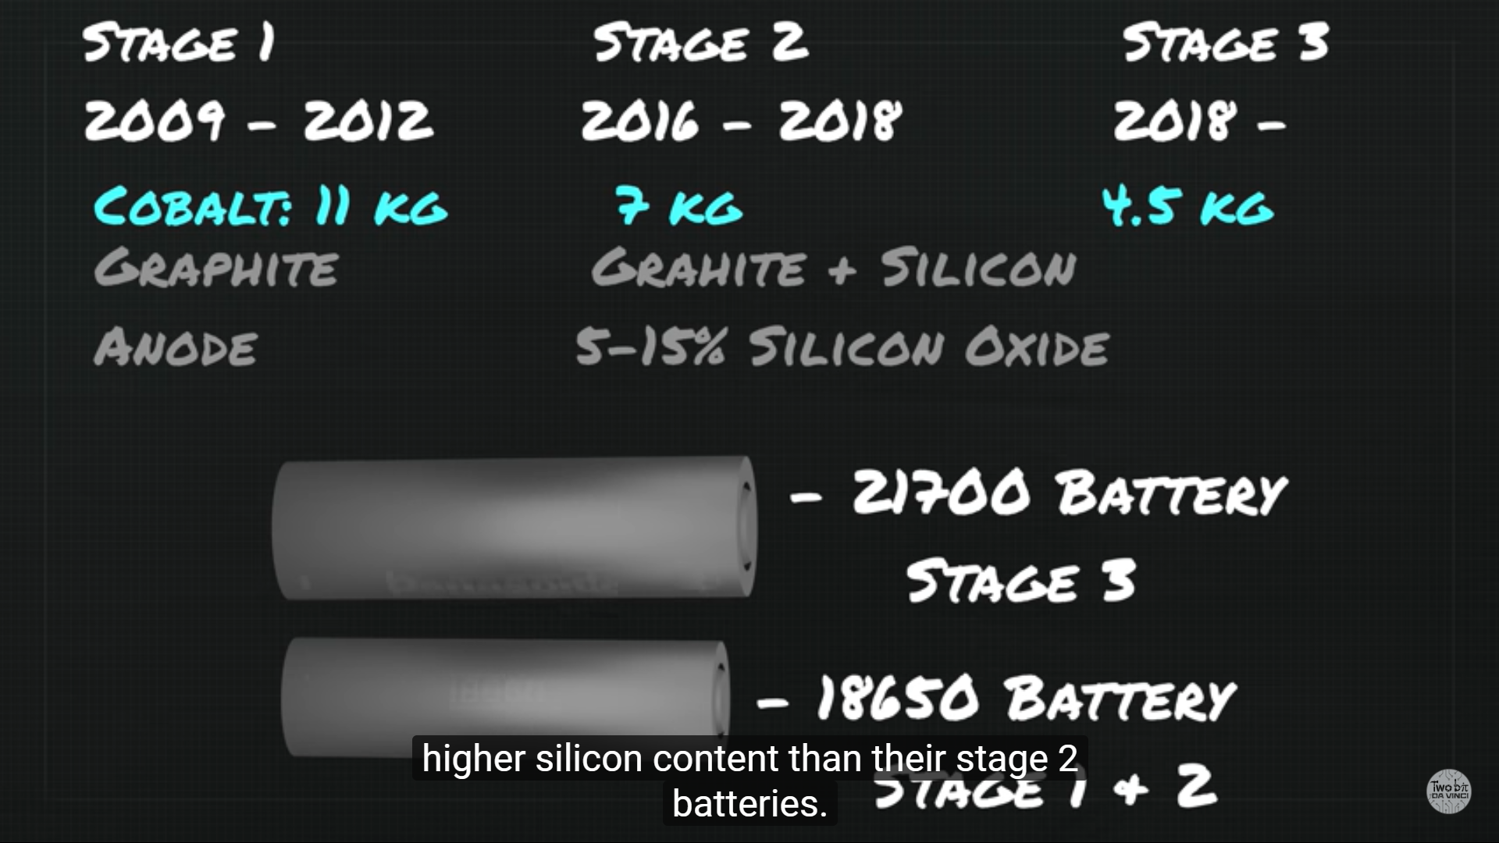
ENERGY STORAGE SYSTEM
The 2170 cell is around 50% larger by volume than the 18650, but it can deliver almost
double the current (the 18650 delivers 3,000 mA, and the 2170 has been tested at 5,750-6,000 mA).
TESLA
Notes:
Tesla has 3 stage development plan as shown, reducing cobalt content in battery for every stage

Slide 33
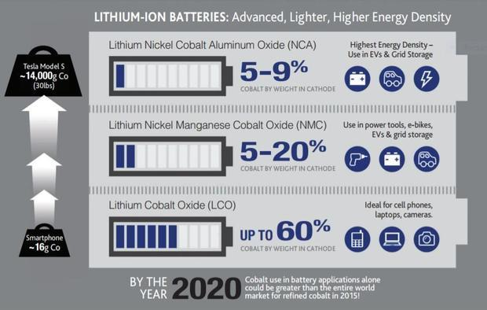
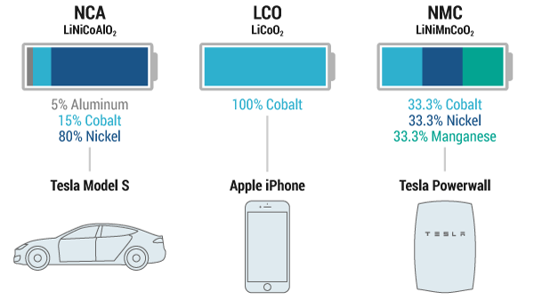
ENERGY STORAGE SYSTEM
The new patent focuses on a new battery cell using two additives in the electrolyte, vinylene carbonate (VC) combined
with 1,2,6-oxodithiane-2,2,6,6-tetraoxide, in order to boost the performance of the cell.
TESLA
Notes:
Tesla uses NCA chemistry, or Nickel, Cobalt, and Aluminium (LiNiCoAlO2) for Model 3
The new battery tested is a Li-Ion battery cell with a next-generation “single crystal” NMC cathode and a new advanced electrolyte.
“In particular, positive electrodes made from single-crystal NMC532 have been shown to be particularly robust, in part because the grain size of NMC532 is larger than the grain size of other standard NMC materials that are more polycrystalline, having smaller grain sizes.”

Slide 34
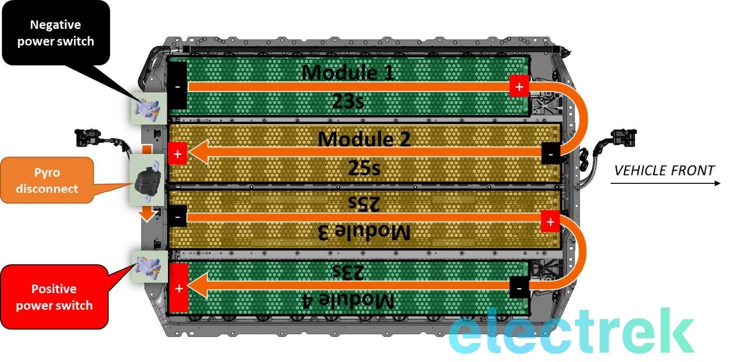
ENERGY STORAGE SYSTEM
High-voltage Electrical Controller and Cooling System
2 Modules of 23 Bricks
2 Modules of 25 Bricks
2,976 to 4416 Cells in groups of 31 to 46 Cells per “brick”
18650->2170
TESLA
Notes:
We already know about the new battery cell format, which is arguably the main change. The cells in Model 3 are a different size than in Model S and Model X, which have cells known as “18 650” (18mm in diameter and 65mm long), while Model 3 has larger cells called “21 70” (21mm in diameter and 70mm long)”.
The bigger cells enabled Tesla to optimize volumetric energy density. The standard 50 kWh Model 3 battery pack is made of 2,976 of those cells in groups of 31 cells per “brick”. The bricks go into 4 separate modules (2 modules of 23 bricks and 2 modules of 25 bricks).
Tesla is producing a 74 kWh ‘long range’ battery pack, which consists of 4416 cells in groups of 46 cells per brick and the same brick distribution in the 4 modules. That’s a big difference with the Model S and Model X battery pack architecture, which has several more modules per pack.

Slide 35
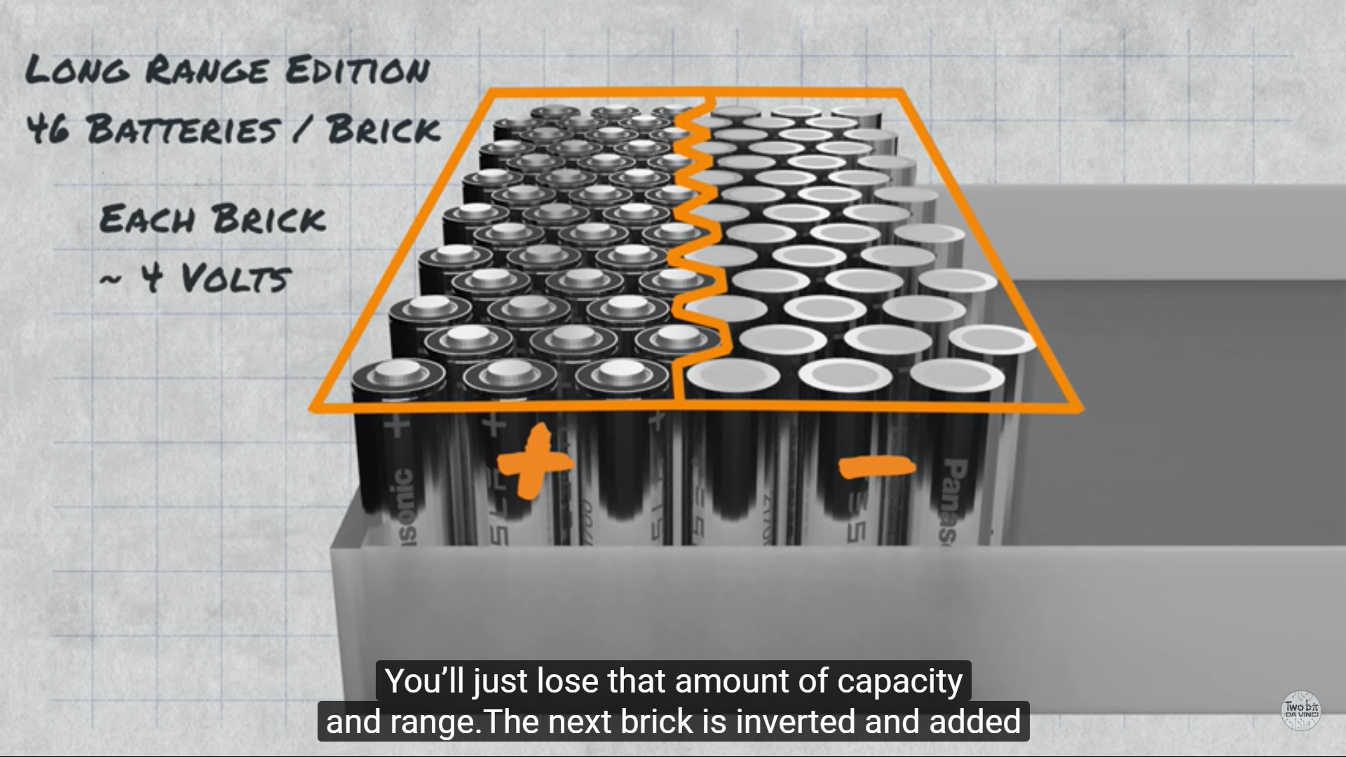
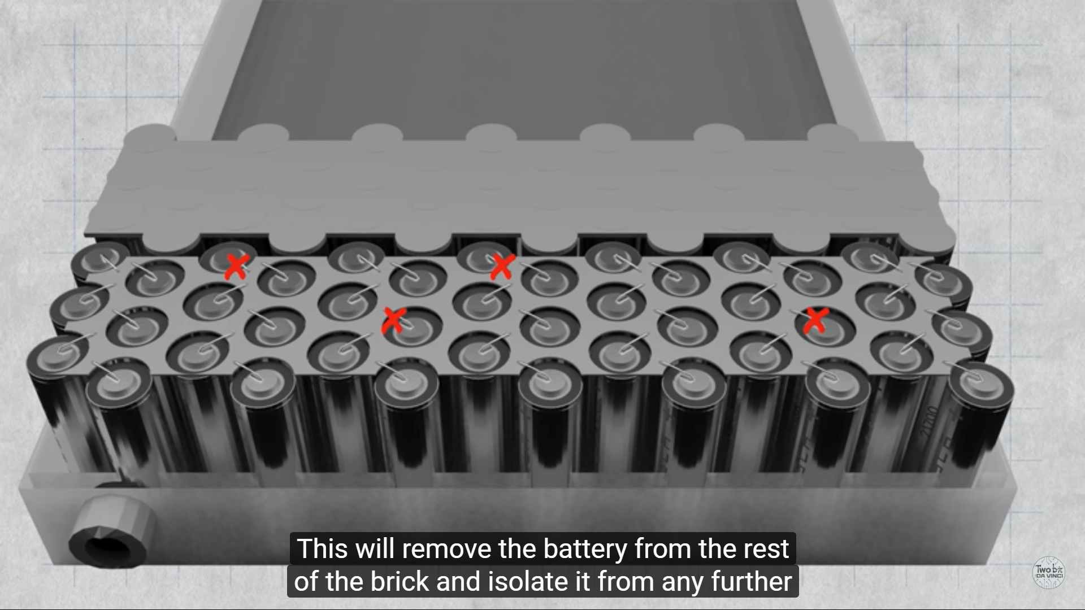
ENERGY STORAGE SYSTEM
Notes:
The bricks function are so that if a battery malfunctioned, it wont lose voltage, it will just lose capacity and range.
The battery are connected by hubs, thin filament are used for fuse, if it overcharge or over discharge, the fuse will automatically be cut and isolate the battery.
To further safety, Tesla 2170 Battery has 3 small holes as vent to discharge electrolyte to prevent pressure build up, and possible explosion

Slide 36
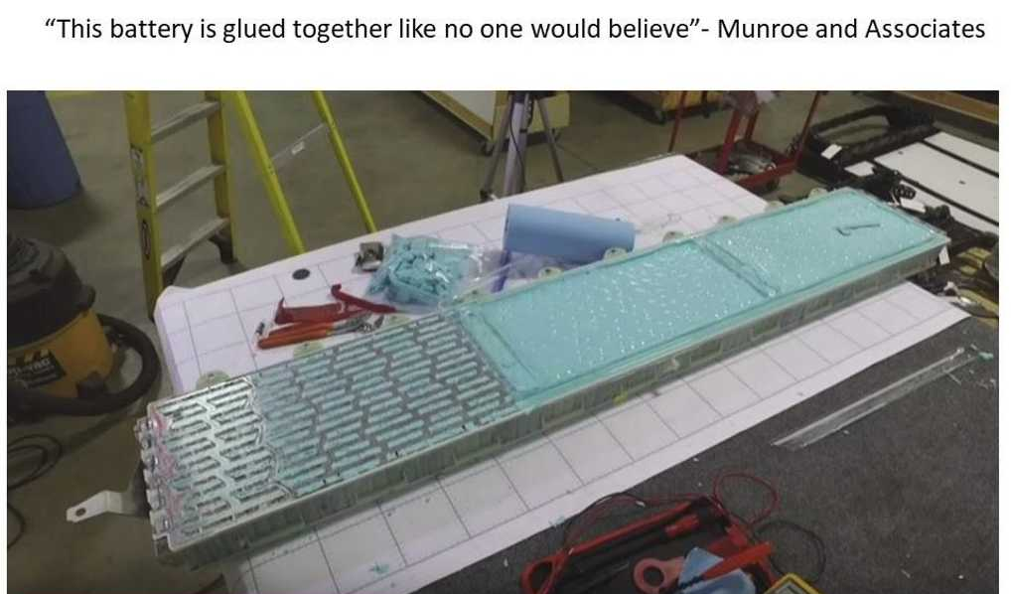
ENERGY STORAGE SYSTEM
TESLA
Notes:
The blue goo is added to improve further stability to the pack and prevent cascading failure (mechanically)

Slide 37
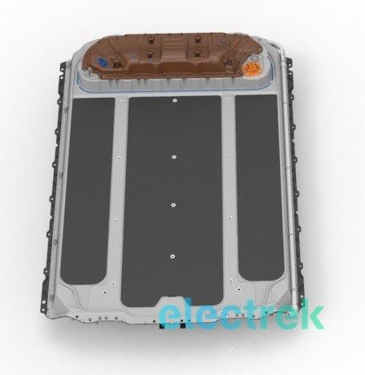

ENERGY STORAGE SYSTEM
TESLA
Notes:
CAD Model and Real Teardown of the battery,
Unlike the Model S and Model X battery pack, Tesla didn’t make the Model 3 battery pack to be easily swappable. There are bolts, which are only accessible by removing trims from the interior of the car, that need to be removed in order to eject the pack.
It’s probably the last blow to Tesla’s battery swap station scheme, which was put on the back burner last year.
Instead, they make new charging system with external cooling

Slide 38

AUTOMATED CHARGING WITH EXTERNAL COOLING
TESLA
Notes:
Another interesting point is that the Model 3 pack has no externally accessible high voltage connector other than the charge port, which kills the idea of an autonomous charging access point under the vehicle – something that Tesla has been working on: Tesla patent shows new way to automated high-speed charging with external cooling.

Slide 39


AUTOMATED CHARGING WITH EXTERNAL COOLING
TESLA
Notes:
Another interesting point is that the Model 3 pack has no externally accessible high voltage connector other than the charge port, which kills the idea of an autonomous charging access point under the vehicle – something that Tesla has been working on: Tesla patent shows new way to automated high-speed charging with external cooling.

Slide 40


AUTOMATED CHARGING WITH EXTERNAL COOLING
TESLA
Notes:
The figure on the left is the automated charging snake-like robot that tesla has developed, the figure on the right is the new automated charging with external cooling

Slide 41



ENERGY STORAGE SYSTEM COOLING SYSTEM
TESLA
Notes:
Water and glycol coolant mixture is pumped through a great thermal conductor and poor electrical conductor

Slide 42


ENERGY STORAGE SYSTEM COOLING SYSTEM
TESLA
Notes:
FIGS.14 and 15 illustrate two such cooling systems. In the embodiment illustrated in FIG. 14, the cooling manifold assembly within battery pack 1401 is coupled to a radiator 1403. Cooling system 1400 may be completely passive or utilize a coolant pump 1405 as shown. In the embodiment illustrated in FIG. 15, the liquid cooling manifold assembly within battery pack 1401 is coupled via a heat exchanger 1501 to a thermal management system 1503. Thermal management system 1503 may utilize a refrigeration system or other means as previously described.
The motorized vents gives airflow, minimizing drag and providing air flow when needed by the radiators

Slide 43

ENERGY STORAGE SYSTEM COOLING SYSTEM
TESLA
Notes:
Alternatively, coolant from air conditioner can be ported for even better cooling

Slide 44


BATTERY MANAGEMENT SYSTEM - BALANCING
TESLA

Slide 45


BATTERY MANAGEMENT SYSTEM - BALANCING
TESLA
Notes:
This shows the process of dynamic balancing, two way power converters are used to balance the charges

Slide 46


BATTERY MANAGEMENT SYSTEM - BALANCING
TESLA

Slide 47


BATTERY MANAGEMENT SYSTEM - BALANCING
TESLA
Notes:
Insert BMS information system

Slide 48


MULTI-CHANNEL AND BI-DIRECTIONAL BATTERY MANAGEMENT SYSTEM
TESLA
Notes:
The battery management system may include a host (such as a microcontroller that manages at a system level) and clients (such as battery management integrated circuits that manage battery cells within the system). In embodiments, the host may be implemented in various structures including the previously mentioned microcontroller and manages the system by transmitting commands and receiving responses from one or more of the clients. Each client may monitor and control corresponding battery cells to measure the electrical and physical status of the cells, such as voltage, amount of remaining electrical charge and temperature of each cell. For instance, the client 120a may monitor the cells 130a. It is noted that each client may monitor a different number of battery cells. The client 120a may perform measurements (e.g., voltage, charge, temperature, etc.) as well as perform certain functions (e.g., bleed-off charge from a battery cell, etc).

Slide 49


THERMAL MANAGEMENT SYSTEM
TESLA

Slide 50

THERMAL MANAGEMENT SYSTEM
TESLA
Notes:
TESLA MODEL 3 Thermal control is a simplified thermal control where all the heat is controlled in one line

Slide 51

THERMAL MANAGEMENT SYSTEM
TESLA

Slide 52

ENERGY STORAGE SYSTEM
TESLA
Notes:
The data is for LR Dual motor (not the performance one)

Slide 53

ENERGY STORAGE SYSTEM
TESLA
Notes:
WLTP Stands for Worldwide Harmonised Light Vehicles Test Procedure
EVDB is https://evdb.io/

Slide 54


ENERGY STORAGE SYSTEM
TESLA

Slide 55

ENERGY STORAGE SYSTEM
TESLA

Slide 56

ENERGY STORAGE SYSTEM
TESLA

Slide 57

CONTROLLER AND ELECTRICAL SAFETY
TESLA

Slide 58

CONTROLLER AND ELECTRICAL SAFETY
1. Charge port connector
2. Fast charge contactor assembly
3. Coolant line to PCS
4. PCS – Power Conversion System
5. HVC – High Voltage Controller
6. Low voltage connector to HVC from the vehicle
7. 12V output from PCS
8. Positive HV power switch
9. Coolant line to PCS
10. HV connector to cabin heater and compressor
11. Cabin heater, compressor and PCS DC output fuse
12. HV connector to rear drive unit
13. HV pyro fuse
14. Fuse
15. HV connector to front drive unit
16. Negative HV power switch
17. Connector for 3 phase AC charging
TESLA

Slide 59

CONTROLLER AND ELECTRICAL SAFETY
TESLA

Slide 60

TESLA

Slide 61
TESLA APP
TESLA

Slide 62




TESLA APP
TESLA

Slide 63


TESLA APP
TESLA

Slide 64




TESLA APP
TESLA

Slide 65

UTILITIES
TESLA

Slide 66
TESLA MODEL E SMART GRID ARCHITECTURE MODEL
TESLA

Slide 67
FIELD-COMPONENT- STATION LAYER
Mechanical Redundancy and ECU for Safety
Ultra high strength steel reinforcement
Modified Suspension Chassis
Three phase power steering motor built in redundancy with Dual ECU
High Voltage Double Protection System
Long Range High Performance Energy Efficient Drive Unit
2 PMSRM Induction Motor
650V SiC MOSFET Based Inverter
Regenerative Braking System
TESLA

Slide 68
FIELD-COMPONENT- STATION LAYER
Long Lifetime Long Range Battery Energy Storage System
2170 Cell Based NCA Battery Pack and BMS
Battery Pack Stabilizer (Vibration redundancy)
Multi-Channel and Bi-Directional BMS
Fast Charging Capability
Supercharger
External Cooling Automated Charging
TESLA

Slide 69
FIELD-COMPONENT- STATION LAYER
Energy Efficient Vehicle Climate Control
Spline Membrane Based Integrated Cooling System (Thermal conditioning and internal component heating system)
User Centered Interface
Autopilot Sensors and GPS
Tablet Based All-in-one User Interface
Tesla Mobile Application
TESLA

Slide 70
REFERENCES
Goodarzi, Gordon A._ Hayes, John G - Electric powertrain _ energy systems, power electronics & drives for hybrid, electric & fuel cell vehicles-John Wiley & Sons (2018)
(US9527403B2) Charging station providing thermal conditioning of electric vehicle during charging session https://patents.google.com/patent/US9527403B2/en
(WO2019006204) Multi-channel And Bi-directional Battery Management System https://patentscope.wipo.int/search/en/detail.jsf?docId=WO2019006204
(US20190280334) NOVEL BATTERY SYSTEMS BASED ON TWO-ADDITIVE ELECTROLYTE SYSTEMS INCLUDING 1,2,6-OXODITHIANE-2,2,6,6-TETRAOXIDE https://patentscope.wipo.int/search/en/detail.jsf?docId=US251449154&tab=NATIONALBIBLIO
(US20110212356A1) Extruded and Ribbed Thermal Interface for use with a Battery Cooling System https://patents.google.com/patent/US20110212356A1/en
(US7841431B2) Electric vehicle thermal management system https://patents.google.com/patent/US7841431
https://www.tesla.com/model3
https://www.teslarati.com/tesla-high-speed-wiring-full-self-driving-safety-patent/
TESLA

Slide 71
REFERENCES
https://www.inverse.com/article/50894-tesla-model-3-charging-without-charger
https://cecas.clemson.edu/cvel/auto/systems/regenerative_braking.html
https://www.researchgate.net/figure/Overall-structure-of-the-regenerative-and-hydraulic-blended-braking-system_fig1_268389110
https://ev-database.org/car/1138/Tesla-Model-3-Long-Range-Dual-Motor#charge-table
https://www.youtube.com/watch?v=QW3PmRp7EK8
https://www.teslarati.com/tesla-model-3-steering-drivetrain-suspension-secrets-revealed/
https://www.carthrottle.com/post/electronic-power-assisted-steering-how-does-it-work/
https://electrek.co/2019/04/13/tesla-model-3-longevity-claims-elon-musk/
https://tsportline.com/blogs/owners-guide/the-tesla-model-3-wheel-guide
https://electrek.co/2017/08/24/tesla-model-3-exclusive-battery-pack-architecture/
https://seekingalpha.com/article/3983102-teslas-gigafactory-christmas-july
https://forums.tesla.com/forum/forums/regenerative-braking-limited
TESLA

Slide 72
REFERENCES
https://www.grin.com/document/341486
https://www.youtube.com/watch?v=vlVFhT-DjnI
TESLA

